Slide 1
Proposed Revision of: NSTM 631 Rev. 3 Dated 01 NOV 2008 S9086-VD-STM-010 NSRP – Surface Preparation and Coatings Panel
Allyson Jones
Engineering Manager
Corrosion and Coatings Engineering Branch, Code 332
Cell: 215-518-5983
Email: allyson.jones@navy.mil
29 - 30 March 2018
DISTRIBUTION A. Approved for public release: distribution unlimited.

Slide 2
CURRENT NSTM 631 ORGANIZATION
Single document containing the following information for ALL Coatings:
Overarching technical policy
Engineering guidance for oversight organizations
Depot-level installation and repair procedures
QA guidance
Material/System descriptions
Ships’ force maintenance procedures
Approved materials list by shipboard space
Material NSNs
Composed of 12 Sections and 304 pages
DISTRIBUTION A. Approved for public release: distribution unlimited.

Slide 3
PROPOSED NSTM 631 ORGANIZATION
NSTM
Chapter 631
REV 3
Preservation of Ships In Service, General
NSTM 631 Volume 1 Revision 4
To Contain:
Overarching technical policy
Engineering guidance
Depot-level authorized repairs
Material/System descriptions
Preservation of Ships In Service, General
NSTM 631 Volume 2 Revision 1
To Contain:
Ships force maintenance procedures
Typical materials list by shipboard space
Material NSNs
Material identification
DISTRIBUTION A. Approved for public release: distribution unlimited.

Slide 4
NSTM 631 VOLUME 1 CONTENT
Philosophy Statement: Volume 1 shall contain a general overview of the coatings technology as well as all necessary information for engineering organizations to make minor technical decisions WRT deviations from the requirements of NSI 009-32.
Material Composition/Chemistries
General Description of Installation and Repairs
Intent of Installations and Repair Requirements
DISTRIBUTION A. Approved for public release: distribution unlimited.

Slide 5
NSTM 631 VOLUME 2 CONTENT
Philosophy Statement: Volume 2 shall contain all necessary information for ship’s force to perform coating repairs and maintenance and to procure all necessary materials.
Repair and Maintenance procedures (replacing PMS cards)
Support transition of ships’ force represervation with performance specifications instead of detail specifications.
NSNs and AELs
Procurement Guidance
DISTRIBUTION A. Approved for public release: distribution unlimited.

Slide 6
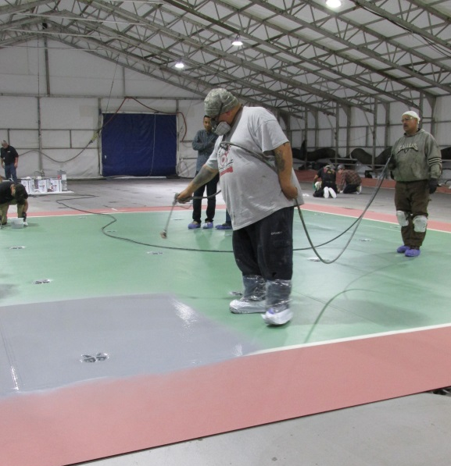
ENGINEERING DOCUMENTATION
NAVSEA STANDARD
ITEM 009-32
(Navy requirements)
Deviation
From Specification
Informed
By
Depot Preservation
NSTM
Chapter 631
VOLUME 1
(intent of
requirements)
ASTM F718
(product
requirements)
DISTRIBUTION A. Approved for public release: distribution unlimited.

Slide 7
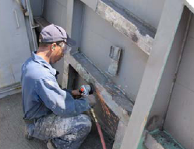
SHIPS’ FORCE DOCUMENTATION
ASSESSMENT
MRC
(Annual)
NSTM 631
VOLUME 2
(preservation
procedures)
2-Kilo
Work Order
Ships’ force Preservation
Informed
By
ASTM F718
(product
requirements)
DISTRIBUTION A. Approved for public release: distribution unlimited.

Slide 8
BENEFITS PROPOSED ORGANIZATION
A clear distinction between engineering guidance for oversight organizations and ships force maintenance capabilities/responsibilities.
An organizational structure that separates technical policy (likely requiring less frequent revisions) from specific maintenance procedures and supporting NSNs (likely requiring regular revisions to reflect new technologies).
Organizational structure is similar to how other technologies are managed therefore promoting consistent TM management throughout the fleet.
DISTRIBUTION A. Approved for public release: distribution unlimited.

