Slide 1
Retention of Type VI Epoxy under UHS Epoxy NSRP Surface Preparation and Coatings Panel 3/29/18
Conlan Hsu Engineer, R&D

Slide 2
Team Members
Ingalls Shipbuilding (Project Lead)
Conlan Hsu, John Hurley, Keith O’Brien, Jay Pertuit
Elzly Technology
Pete Ault, Eric Shoyer
Bath Iron Works
Robert Cloutier
ATI
Frances Pearce (Project Manager)
Electric Boat
Mark Gaynor (Project Technical Representative)

Slide 3
Project Concept
Current specifications for tanks and critical spaces require a MIL-PRF-23236 Type VII Ultra High Solids (UHS) epoxy coating over bare steel
This requires either retaining Pre Construction Primer (PCP) through the entire build process until late-stage final paint application, or to apply the first coat of a multi-coat Type VII epoxy earlier in the build
PCP will not provide adequate corrosion protection of the steel over long periods of weather exposure
UHS epoxy can be damaged or burned during construction, and is difficult and expensive to repair
This project will develop the data needed to request Navy approval to apply a Type VII UHS epoxy over a Type VI epoxy in critical coated areas
Type VI epoxy could economically bridge this gap if it can be retained for final painting

Slide 4
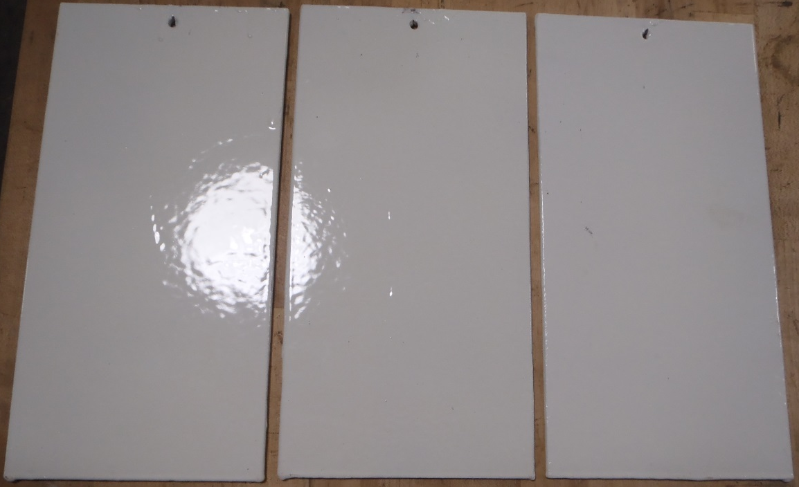
Project Work Breakdown Structure (WBS)
Task 1: Identify Target Applications, Requirements, and Constraints
Task 2: Select Candidate Systems
Task 3: Finalize Applications and Test Requirements
Task 4: Develop Test Plan
Task 5: Fabricate Test Articles
Task 6: Perform Testing
Task 7: Issue Final Report

Slide 5
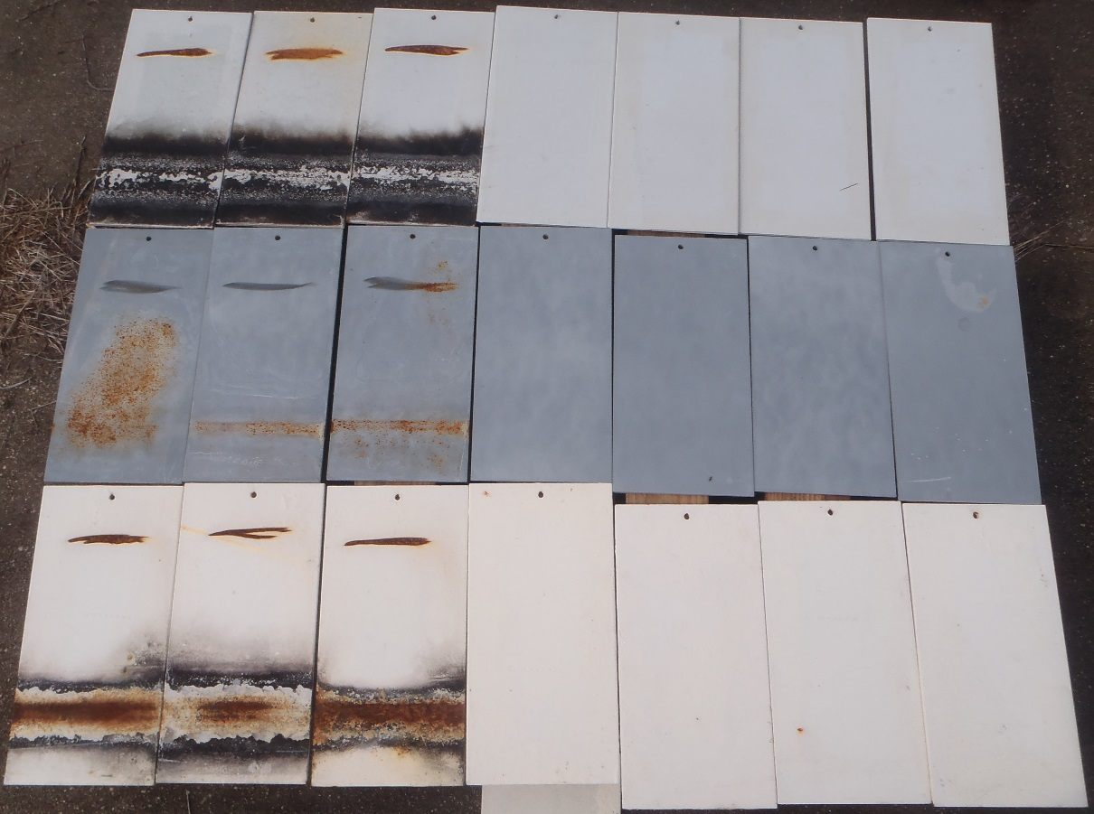
Test Strategy
6”x12”x1/8” steel panels
Apply initial coat
Simulate burn/weld defects
For adhesion & salt fog panels
Age & weather for 7 months
Secondary surface prep
Apply final coat
Perform testing

Slide 6
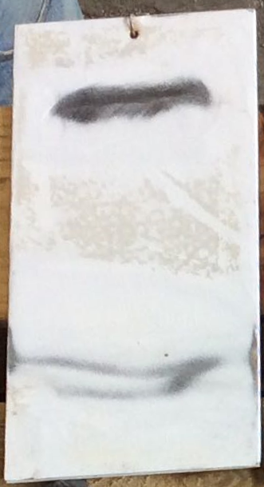
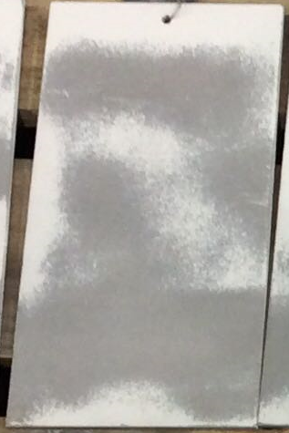
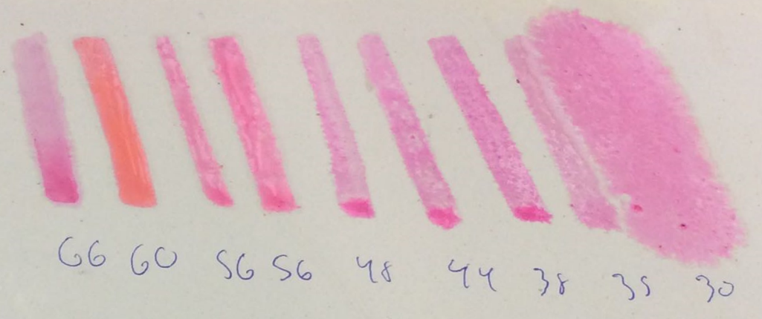
Secondary Surface Preparation
Surface Preparation Methods
SP-3/SP-11
SP-7/SP-10
SP-14/SP-10
Characterizing Secondary Surface Preparation
Visual Inspection
Film Thickness
Surface Profile
Prepared Coating Surface Tension
Dyne Pens (experimental)
SP-11
SP-10
SP-10
SP-3
SP-7
SP-14
SP-11
SP-10
SP-10

Slide 7
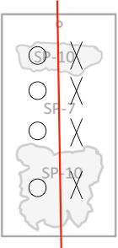
Test Methods
Pull Off Adhesion (ASTM D4541)
Knife Adhesion (ASTM D6677)
Flexibility (Bend Test)
Prohesion (Cyclic Corrosion Exposure) (ASTM G85 Annex A5)
Cathodic Disbondment (MIL-PRF-23236D)
Condensing Humidity (ASTM D4585)

Slide 8
Next Steps
Conduct Testing
Prohesion (1000 hr)
Cathodic Disbondment (90 day)
Condensing Humidity (2000 hr)
Complete Test Reports (6/1/18)
Submit Final Report (6/30/18)
Pursue Navy Approval

