Slide 1
Distributed Temperature Sensing for Inspection of Electrical Panels on Navy Ships
Jeff Callen
Penn State Electro-Optics Center
jnc13@arl.psu.edu
NSRP ETP March 28, 2018
Charleston, SC
A: Approved for public release: distribution unlimited

Slide 2
Presentation Outline
Background
Approach
Project Goals
Technical Approach
Schedule
Trade Study Technical Details
Bench Demonstrations
Visit to Ingalls Shipyard
Trade Study Results
Final Demonstration
Conclusions
A: Approved for public release: distribution unlimited
Distribution Statement A: Approved for public release: distribution unlimited

Slide 3
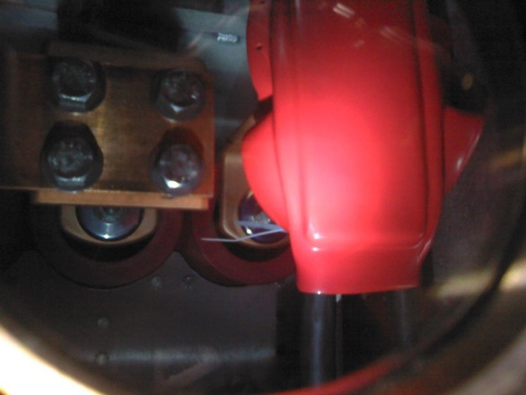
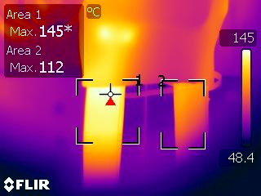
Background
Loose connections in electrical switchgear presently detected with infrared thermography. Thermography through IR windows (to address safety issues) is viable but
Providing line of sight is a significant design challenge for the panel manufacturers due to density of components inside cabinet - 100 % coverage of all connections might not be possible.
Insulating dust boot materials are not transparent to IR wavelengths and the temperature of the connection can only be inferred from hotspots on the outside of the boot or the cable exiting the boot.
Visible image through window. Red dust boot covering connections
Thermal image of dust boot and cables with simulated fault
Distribution Statement A: Approved for public release: distribution unlimited

Slide 4
Approach
Investigate the viability of Distributed Temperature Sensing (DTS) over optical fiber for monitoring of switchgear connections. Benefits will include:
Sensor is the fiber itself or is inside the fiber. Can sense anywhere fiber can be run.
Likely 100% coverage of all connections, beneath the dust boots and independent of window placement, for safer inspection.
Programmable temperature monitoring, available on demand, or optionally permanently installed for continuous monitoring. Less interpretation of results.
If continuous, can alert to problems as they develop, not when approaching failure. Enabler to predictive maintenance.
Distribution Statement A: Approved for public release: distribution unlimited

Slide 5
Project Goals
Determine feasibility of using DTS in shipboard cabinets and whether 100% coverage is practical
Provide demonstration of proof of concept in a relevant environment (representative electrical cabinet)
Establish trade space for different DTS technologies with respect to use in Navy Ships
Distribution Statement A: Approved for public release: distribution unlimited

Slide 6
Technical Approach (from SOW)
Review challenges to IR inspection and refine requirements √
Perform trade study of four DTS technologies with respect to application on Navy ships (4160V panels) – √
Arrange benchtop demonstrations of four technologies geared toward this application. √
Visit to shipyard to view distribution of electrical cabinets on ship √
Downselect to technology most suited for this application based on results of trade study and demos – √
Arrange a final demonstration in a relevant environment - pending
Develop a path for technology transfer. – in progress
Distribution Statement A: Approved for public release: distribution unlimited

Slide 7
Schedule
Period of performance – 1/16/17 through 4/16/18 – NCE to 5/31/18 applied for.
Exact schedule will be dependent on availability of vendors for arranging demonstrations and venues.
Schedule targets are
Refine requirements – Apr/May 2017
Perform trade study – June/July 2017
Benchtop demonstrations – Aug/Sept 2017
Downselect to single technology – Dec – Feb 2018
Plan and perform final demonstration – April 2018
Submit Final Report – May 2018
Distribution Statement A: Approved for public release: distribution unlimited

Slide 8
Trade Study Details
Study evaluates technical feasibility, reliability, implementation and maintenance requirements, and costs wrt implementation on Navy ships (focus on 4160 V systems)
Identified DTS technologies to compare:
Raman Shift
Rayleigh Scattering
Fiber Bragg Gratings
Brillouin Scattering
Vendor features and performance evaluated against requirements document and sample implementation on representative Navy ship
Maintain sensitivity to proprietary and competition-sensitive information from vendors.
Distribution Statement A: Approved for public release: distribution unlimited

Slide 9
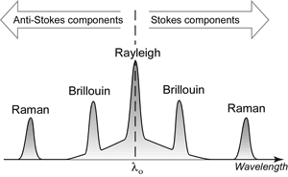
Raman Shift
Light is scattered in optical fibers from microscopic defects or inconsistencies. There are three scattering processes – Rayleigh, Brillouin and Raman
Raman makes use of collisions of photons with atoms or molecules along the optical fiber. The reflected light is shifted in wavelength.
If photon loses energy to the fiber wall, the scattered wavelength is longer (known as the Stokes Component). If it gains energy, the wavelength is shorter (Anti-Stokes).
Anti-Stokes is sensitive to temperature. Ratio of two signals corresponds to temperature change in fiber.
Optical Frequency Domain Reflectometry (OFDR) determines the timing of the return signal which locates it along the fiber.
Distribution Statement A: Approved for public release: distribution unlimited

Slide 10
Rayleigh Backscattering
Reflection of light from structures (impurities) in an optical fiber are unique to that fiber
OFDR sweeps a broad spectrum of light down the fiber. Strain or temperature alters the reflection
Comparing the reflection to a reference shows the temperature difference
An FFT on the returned signal converts it to the time domain to determine the distance down the fiber
Distribution Statement A: Approved for public release: distribution unlimited

Slide 11
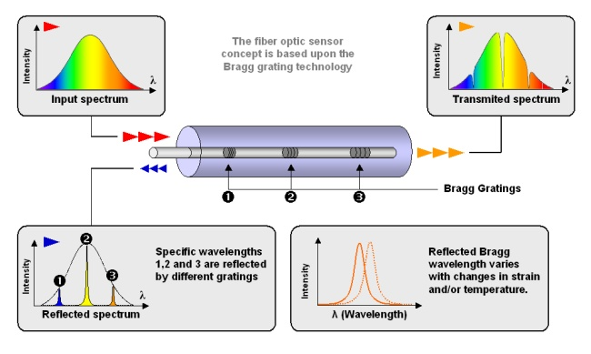
Fiber Bragg Gratings (FBG)
An interferometer is etched directly onto the fiber.
Each interferometer reacts to a very narrow spectrum.
A wideband signal is sent down the fiber to excite. Each grating reflects at its own wavelength
A spectrometer looks at the return signal. The amount of wavelength shift indicates the temperature rise.
The particular wavelength that shifted indicates which sensor was affected by the temperature difference.
Distribution Statement A: Approved for public release: distribution unlimited

Slide 12
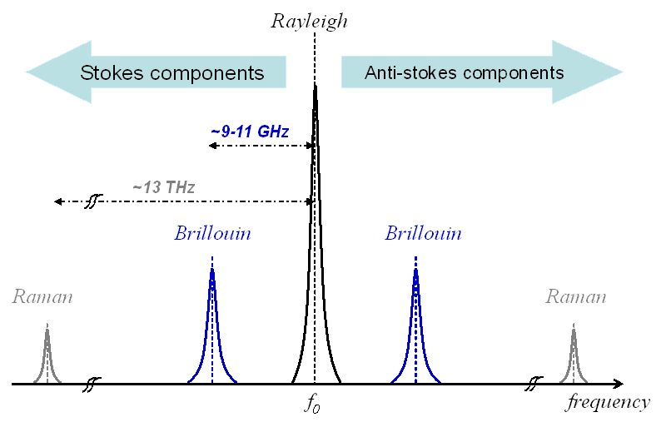
Brillouin Scattering
Interaction of light photons with acoustic or vibrational quanta (phonons) at naturally occurring inconsistencies in index of refraction. Shift of 11 GHz (ultrasound) but very small signal.
Detectable with BOTDR (Brillouin Optical Time Domain Reflectometery) – single fiber - Compares transmitted to received signal – weak signal
Or, can use BOTDA (Brillouin Optical Time Domain Analyzer) – dual fiber. Pump laser down second fiber provides coherent amplification of the Brillouin scattered light and high dynamic range.
Lengths in kms. 10 cm spatial resolution. May require loop of fiber around measurement point. More suitable for long distances.
Dropped from comparison
Distribution Statement A: Approved for public release: distribution unlimited

Slide 13
Benchtop Demonstrations
Demonstrations at Penn State Electro-Optics Center (EOC)
Micron Optics, Atlanta, GA – Fiber Bragg Gratings – August 25, 2017
Luna, Roanoke, VA – Rayleigh Backscatter – August 28, 2017
Optromix, Cambridge, MA – Fiber Bragg Gratings – September 7, 2017
RSL Fiber Systems, E. Hartford, CT – Raman Backscatter – September 8, 2017
It was not possible to arrange a demo with Brillioun Backscatter vendor
Demonstration format
Each vendor invited to provide a prepared demo (“trade show” level) of their equipment
Vendor’s equipment was tried on EOC test rig. Spot checks with a thermocouple used for comparison.
Discussion of features of equipment. Each vendor given a sketch of typical arrangement of connections to be monitored inside an electrical cabinet and a sketch of a notional deployment of cabinets on a ship the size of the LHA series.
Vendors asked to refine their original proposals that were in response to the requirements document sent out previously.
Distribution Statement A: Approved for public release: distribution unlimited

Slide 14
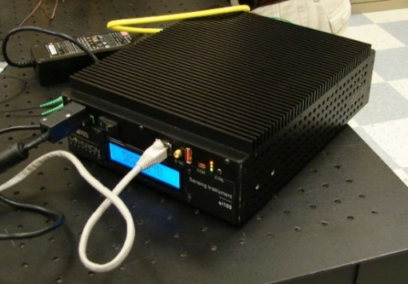
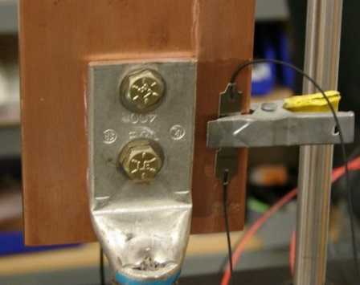
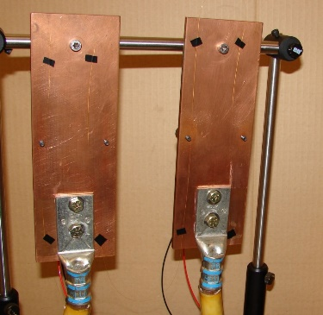
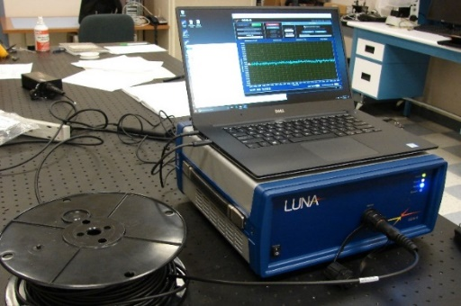
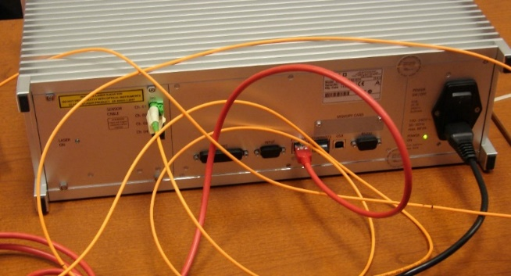
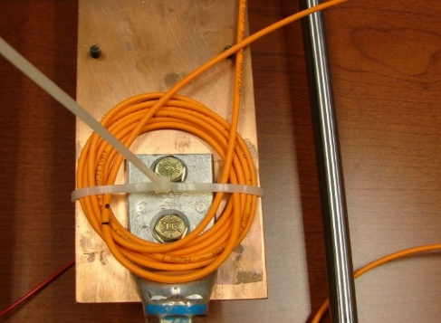
Benchtop Demonstrations - Images
Interrogator
Sensor
Fiber Bragg Grating
(Micron Optics)
Rayleigh Backscatter
(Luna)
Interrogator
Sensor
Sensor
Raman Backscatter
(RSL)
Distribution Statement A: Approved for public release: distribution unlimited

Slide 15
Benchtop Demo Summary - 1
FBG systems use a point sensor. Raman and Rayleigh measure anywhere along the fiber. In practical application, the fiber at the measurement point will need to be in a rugged and easily installed package, making it effectively into a point sensor
All systems make absolute measurements – alarms based on above or below threshold. There is limited ability to make relative comparisons between measurements, although future software changes may enable this.
All systems are set up to offload data to a supervisory computer (e.g. Machinery Control System – MCS). Software in the MCS can compare between measurement points and set alarms on various conditions. So while none of the systems can make the comparison measurements required in this application, all of them can offload the data to a computer that can.
Distribution Statement A: Approved for public release: distribution unlimited

Slide 16
Benchtop Demo Summary - 2
All systems have a laptop computer for setup and display of data if required. In production setting, laptop will not be part of permanent installation.
All of the systems except the Raman reported temperatures within one or two °C of the thermocouple checks.
Raman system temperature read lower (10 °C or more) than thermocouple check. The Raman vendor is exploring mitigations to the observed temperature lag.
None of the vendors offers MIL-qualified equipment. Most offer rugged industrial grade electronics. Protection of the fiber for installation into electrical cabinets will need to be considered.
Distribution Statement A: Approved for public release: distribution unlimited

Slide 17
Visit to Ingalls Shipyard
Tour of LHA-7 as representative – October 18, 2017
Toured LHA-7, at HII, Pascagoula MS for better understanding of fiber routing issues in an actual installation.
Viewed port side 4160VAC cabinets. Noted cabinet types and locations. Starboard side similar but distributed differently.
Cabinets are on multiple decks and distributed fore and aft. Cabinets on the same circuit may be in different compartments or on different decks.
Discussion on practical aspects of incorporating Fiber Optic temperature sensing:
Consider costs not just of DTS equipment, but added costs of installation (mounting electronics, making connections, etc.).
Machinery Control System (MCS) is a supervisory computer that examines data from sensors all over the ship. Ideal place for DTS to send its data for analysis and generating alarms.
Ruggedization of fiber sensors inside cabinet is imperative due to environment of installation. Anything delicate is likely to get damaged. Perhaps a premade fiber harness can be installed after connections are made
Distribution Statement A: Approved for public release: distribution unlimited

Slide 18
Implementation Scenario
Panel manufacturer creates spec for fiber sensor for each cabinet type.
Fiber vendor produces fiber cable harness per panel manufacturer spec.
Panel manufacturer installs fiber harness during assembly of panel. Shipboard connection points may be handled separately.
Panels installed aboard ship at shipyard. Each fiber harness has connection or fusion point where it enters and exits panel.
Shipyard installs interrogator and runs connecting fiber to panels and between panels
At panels, shipyard connects fiber runs to harnesses in panels. Each panel is chained to the next to the limits of the technology (panels are in series)
DTS interrogator connected by network to supervisory computer.
Fiber sensors and harnesses must be rugged and easy to install. Premade harnesses simplify installation inside panels.
Shipyard will not install fiber in panels, except perhaps around connections made by shipyard. Could be a separate harness.
Distribution Statement A: Approved for public release: distribution unlimited

Slide 19
Trade Study Comparison
 | Raman | Rayleigh | FBG (Micron Optic) | FBG (Optromix)
Sensing | Anywhere along fiber | Anywhere along fiber | At embedded sensors¹ | At embedded sensors¹
Points per channel | 1000 | >1000 | 79 | 20
# channels/interrogator² | 4 | 4 | 16 | 8
Length limitation | 30 km | 50 m ³ | 5 km | 100’s of meters
Connection method⁴ | Splice | Splice or connector | Splice or connector | Splice or connector
Connection notes | Requires coil of fiber⁵ | Requires local module⁶ | As is | As is
Determine location⁷ | Calibrate or Measurement | Calibrate or Measurement | Construct per spec | Construct per spec
Bench test performance | Read >10 °C low⁸ | Within 2 °C of reference⁹ | Within 2 °C of reference⁹ | Within 2 °C of reference⁹
Installation notes | Create encapsulated coil¹⁰ | Ruggedize fiber¹¹ | Screw, weld or epoxy¹² | Epoxy or weld¹³
Material Cost for LHA-7¹⁴ | $78,740 | $658,500 | $221,600 | $327,950
# of interrogators LHA-7 | 1 | 6 | 2 | 5
% total cost electronics¹⁵ | 57 % | 98 % | 20 % | 38 %
Distribution Statement A: Approved for public release: distribution unlimited

Slide 20
Raman Issues
Raman system has advantages in cost and ability to make 1000s of measurements.
In tests at EOC Raman consistently read lower temperatures than the reference thermocouple.
System needs to take readings from about a meter worth of fiber to determine an accurate temperature which must be coiled around measurement point.
Coil loops at bottom, against bus bar, are hotter than those at the top, which sit on other coil loops. System averages all of these together resulting in lower reported temperature.
Recent tests by RSL (Raman vendor) show better accuracy for larger coil length (2 meters) and allowing for a modest time lag. As temperatures in the switchgear are not expected to change rapidly, this is encouraging. More data to follow.
Another proposed solution is to encapsulate the coil in a disc shaped configuration with a potting material that can transfer the heat to all the coil loops. Some insulation from ambient may also be required.
This has not been tested.
Distribution Statement A: Approved for public release: distribution unlimited

Slide 21
Trade Study Downselect
IPT selected Fiber Bragg Grating (FBG) (Micron Optics) for final demo
FBG makes accurate measurements and is easily implementable.
COTS sensors can be spliced into arrays and screwed, glued or clamped.
Calibration done electronically
Capability of electronics results in reasonable mid level costs.
Raman backscatter has advantages in costs and measurement capability, but has issues
Measurement accuracy initially unacceptable, but recent tests show promise. Consideration is still a possibility.
Fiber needs to be made easily implementable
Calibration needs to be done after installation
The Rayleigh backscatter method, while accurate, is not as suitable for shipboard implementation
Fiber would need to be ruggedized
Fundamental limitation on fiber length drives to high costs, with multiple interrogators needed.
Distribution Statement A: Approved for public release: distribution unlimited

Slide 22
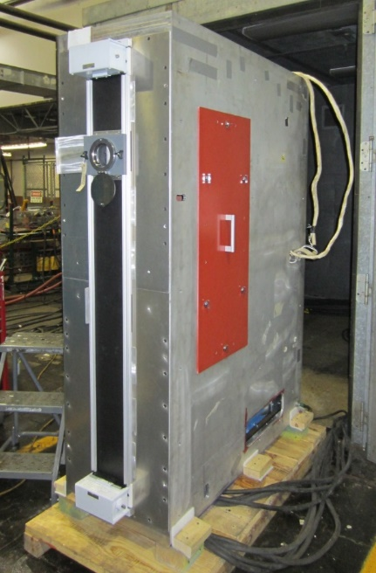
Final Demonstration
Electrical Panel manufacturer DRS has offered test cell and facility at location in Milwaukee, WI
Actual 4160V cabinet. Test cell can run low voltage, high current through connections to simulate normal operations or safely simulate a fault.
Fiber Bragg Grating vendor Micron Optics to supply DTS system for test
DTS system sensing will be installed on 3 phases of connections in cabinet. Data taken during simulated normal operations. Connection will be loosened and data recorded again.
Will repeat tests with different attachment method (clamps versus epoxy)
Discussion and possible variations of tests.
Scheduled for April 24 and 25, 2018
Distribution Statement A: Approved for public release: distribution unlimited

Slide 23
Conclusions
DTS represents a potential long term full coverage solution to inspection for loose connections in electrical panels
The technology can go beyond the present inspection needs if continuous monitoring is implemented.
Alarms can be programmed to alert when situations start to develop, rather than detecting them when they are close to crisis.
Data can be collected for reliability and preventive maintenance purposes
Electrical current usage downstream of the switchgear can be monitored for trends and predictive maintenance purposes
Rayleigh not suitable, but Raman and FBG differ enough that costs and utility will be specific to the application.
Demonstration should provide more insight into practical considerations.
Distribution Statement A: Approved for public release: distribution unlimited

Slide 24
Backups
Distribution Statement A: Approved for public release: distribution unlimited

Slide 25
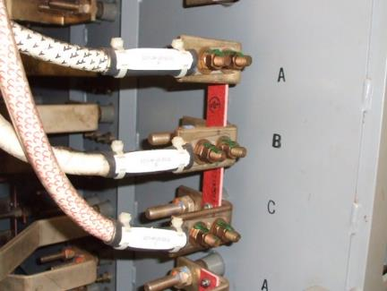
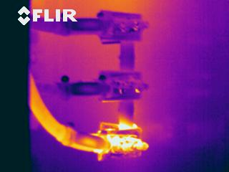
Background
Even under best practices, shipboard switchboards can develop loose connections that lead to arc faults and other electrical issues
Average of 8 arc faults per year throughout the navy fleet - all occurred in Switchboards and Load Centers - cost Navy millions of dollars in downtime and repairs [NAVSEA, SUPSHIP Gulf Coast]
Newer ships have electrical systems considered medium to high voltage
LHD, LHA, DDG-51(FLTIII), DDG-1000 = Medium, 4160 volt systems (CVN = High, 13,800 volts)
Switchboard Inspections are done during construction, builder’s trial, during sea trials, and again at regular maintenance intervals
Current inspection methods: typically utilize Thermal IR imagers to investigate cabinets and comparatively identify ‘hotspots’; other investigation modes require close proximity interrogation
Temperature difference between phases
Load Center
Photos from NSWC Philadelphia
25
Distribution Statement A: Approved for public release: distribution unlimited

Slide 26
Background - Issues
Connections in electrical panels on Navy Ships are presently inspected using infrared thermography through open panel while under load. A bad connection shows up as much hotter than connections on adjacent phases.
Medium to high voltage panels require OSHA waivers or preclude open panel inspection at all.
Recently concluded NSRP panel project investigated use of IR transparent windows in panel covers to permit thermography without opening the panel.
Distribution Statement A: Approved for public release: distribution unlimited

Slide 27
Active Project Participants
Lead Investigators
Jeff Callen | Penn State Electro-Optics Center Research and Development Engineer, Electrical Engineering and Systems Engineering | jcallen@eoc.psu.edu
John Mazurowski | Penn State Electro-Optics Center Subject Matter Expert – Fiber Optic Systems | jmazurowski@eoc.psu.edu
Sponsoring Shipyard
Jason Farmer | Ingalls Shipbuilding (Pascagoula) Project Lead / Electrical Engineer IV | jason.farmer@hii-ingalls.com
Government Stakeholder
Clay Smith | SUPSHIP Gulf Coast Engineering | david.smith@supshipgc.navy.mil
Project Technical Representative
Richard Deleo | Newport News Shipbuilding Engineering Manager - Submarine Electrical | r.deleo@hii-nns.com
Distribution Statement A: Approved for public release: distribution unlimited

Slide 28
Integrated Project Team (IPT) Advisors and Other Stakeholders
Government Stakeholders
Dave Mako | NSWC Philadelphia Division, Code 427, Propulsion & Power Systems | charles.mako@navy.mil
Chris Nemarich | Naval Sea Systems Command, Electrical Systems SEA 05Z32 | christopher.nemarich@navy.mil
Industry Advisors
Gary Weiss | DRS Power & Control Technologies, Inc. Business Development Manager for Power Distribution and Power Conversion | garypweiss@drs.com
Distribution Statement A: Approved for public release: distribution unlimited

Slide 29
Raman Shift - Pros and Cons
Pro
Equipment exists – can bench demo as is
Can calibrate for any temperature range
Senses anywhere along the fiber
Can program gating to sense specific areas along fiber
Up to 16 channels per controller (interrogator)
Distance aboard ship no problem (good to many km)
Uses standard shipboard fiber, attached by adhesive or clamp
Programming for alarms can be very specific to application
Continuous monitoring not a problem – can average measurements, alert on differences, offload data to DAQ
Distribution Statement A: Approved for public release: distribution unlimited

Slide 30
Raman Shift - Pros and Cons
Con
Spatial resolution only 50 cm (possibly can be improved with programming) – may need loops between adjacent measuring points
Requires fusion splices rather than connectors (complicates installation and maintenance)
May need different fiber for high temperature extremes
Requires loop of fiber at measurement point to get sufficient signal over noise
Possible susceptibility to single point failure, with multiple sensors on same fiber
Requires more laser power than Rayleigh Scattering.
Distribution Statement A: Approved for public release: distribution unlimited

Slide 31
Rayleigh Backscatter – Pros & Cons
Pro
Equipment exists – can bench demo as is
Senses anywhere along the fiber
Very good spatial resolution (5 mm), so no looping of fiber
Standard sensors of 5 m or 10 m length can yield hundreds of readings.
Can translate data to a map type display locating measurements in a physical space
Programming can be set up for averaging, continuous monitoring, various alarms. Can offload to a DAQ
Interrogator is single channel, but 8:1 and 36:1 optical switches can be used for multiplexing
Can use connectors
Software can identify the individual sensor fibers, so wiring errors are minimized
Can use adhesive or clamps
Software SDK is available for custom programming
Distribution Statement A: Approved for public release: distribution unlimited

Slide 32
Rayleigh Backscatter – Pros & Cons
Con
Only short range – Interrogator has to be within 50 m of sensor fibers
Each machinery room would require its own interrogator, unless rooms were adjacent
Cost may be a factor due to number of interrogators required. Multiplexers are added cost.
Possible susceptibility to single point failure with multiple sensing points on a single fiber.
Distribution Statement A: Approved for public release: distribution unlimited

Slide 33
FBG – Pros and Cons
Pro
Identification of sensor by bandwidth is very precise
Many measurements on same fiber are possible, since the bandwidth of individual sensors is very narrow
Total length of cable not a problem for ship installation
Can multiplex many sensors into the same interrogator
Very good spatial resolution (< 1 cm)
Identification of individual sensors allows for series or branch configuration – more flexible installation
Branches done by splicing (optical splitters)
Branches are less susceptible to single point failure
Distribution Statement A: Approved for public release: distribution unlimited

Slide 34
FBG – Pros and Cons
Con
Equipment can be borrowed for demos, but will likely need to have sensor fibers made up for tests
Multiple fiber junction boxes might be difficult to fit inside switchgear cabinets
Position of gratings must be carefully mapped out before production and later changes would require replacement of sensors, rather than reprogramming
Cost may be a factor. Interrogator cost is dwarfed by the fiber manufacturing and installation costs
Distribution Statement A: Approved for public release: distribution unlimited

Slide 35
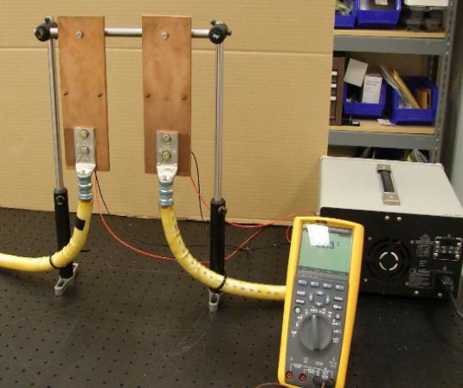
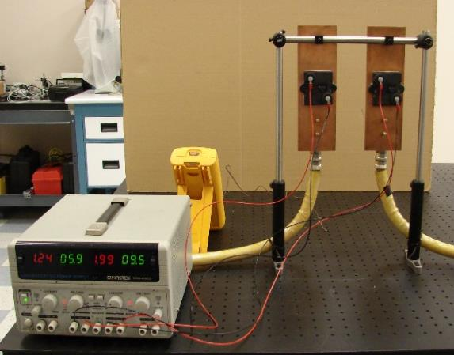
Benchtop Demonstrations - 2
Penn State EOC Test Setup
Resistance Heaters
Bus Bar
4160V Power Cable
Power Supply
Thermocouple/meter
Distribution Statement A: Approved for public release: distribution unlimited

Slide 36
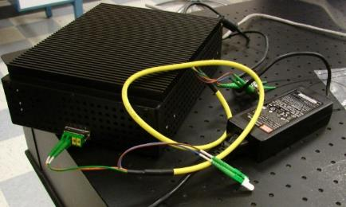
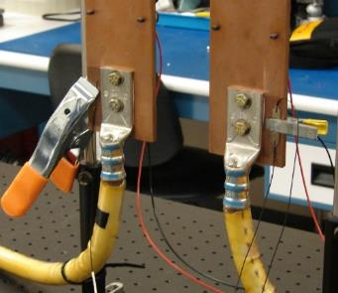
Benchtop Demo FBG - 1
Micron Optics
Micron Optics Hyperion Interrogator
Micron Optics FBG Sensors on Penn State Test Rig
Distribution Statement A: Approved for public release: distribution unlimited

Slide 37
Benchtop Demo FBG - 1
Micron Optics Summary
Fairly small, low power interrogator. A sixteen channel interrogator is available.
Sensors typically sold as individual single measurement devices, but custom arrays possible.
Up to 79 sensors in series are available per interrogator channel. (bandwidth limited)
Regular fiber lead cable can be used between interrogator and sensing cable.
Demonstration performed well on EOC test rig with sensor clamped.
Distribution Statement A: Approved for public release: distribution unlimited

Slide 38
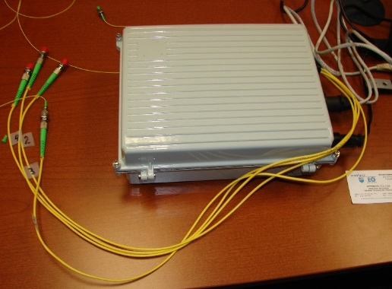
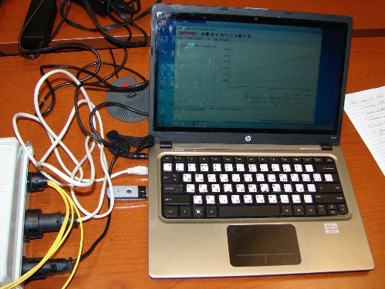
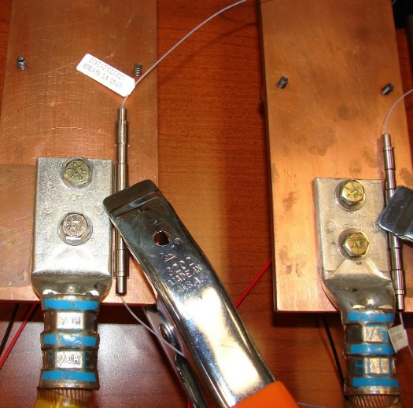
Benchtop Demo FBG - 2
Optromix
Optromix Interrogator and Laptop Interface
Optromix FBG Sensors on Penn State Test Rig
Distribution Statement A: Approved for public release: distribution unlimited

Slide 39
Benchtop Demo FBG - 2
Optromix Summary
Rack mount, low power interrogator. An 8 channel interrogator is available (not one pictured)
Sensors typically sold as individual single measurement devices, but custom arrays would be proposed.
Up to 25 sensors in series are available per interrogator channel (bandwidth limitation)
Regular fiber lead cable can be used between interrogator and sensing cable.
Demonstration performed well on EOC test rig with sensor clamped. Slight calibration anomaly.
Vendor indicated that for production, much can be customized, including sensor mounting.
Distribution Statement A: Approved for public release: distribution unlimited

Slide 40
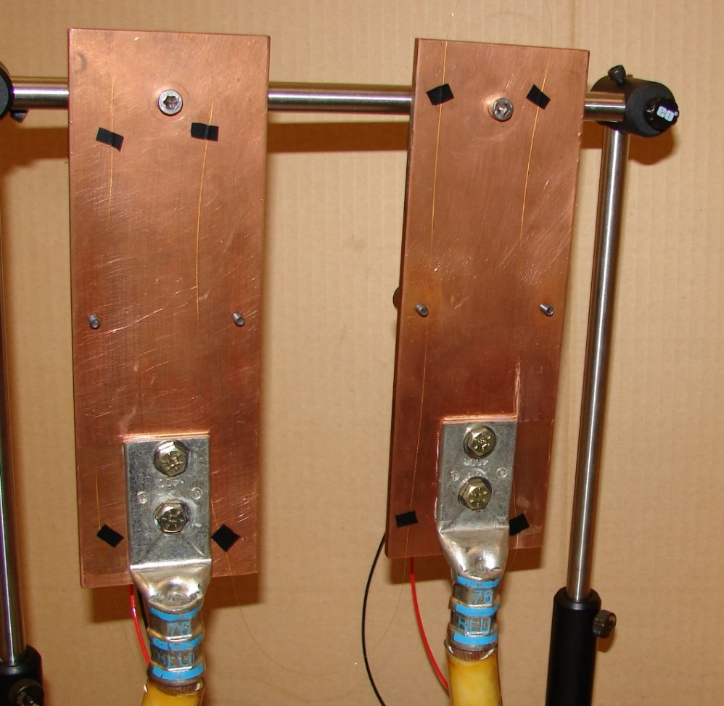
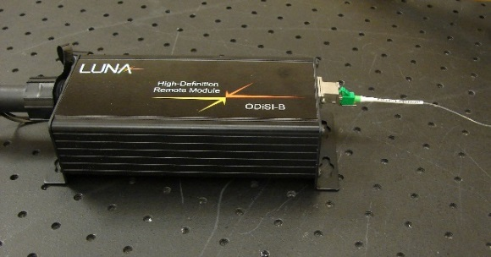
Benchtop Demo Rayleigh
Luna
Luna Interrogator and Laptop Interface
Remote Module: Local Temp Compensation
Luna Fiber Sensor on Penn State Test Rig
Distribution Statement A: Approved for public release: distribution unlimited

Slide 41
Benchtop Demo Rayleigh
Luna Summary
Somewhat larger, but still low power interrogator. Each channel requires a small remote module at the far end of the lead cable to correct for local differences in ambient temperature and vibration. 8 channels available.
Sensor is a fiber optic cable. As sold off the shelf it is coated but not jacketed. It would need protection for installation in an industrial environment.
Sensor cable is max of 50 meter length, but can make measurements as close as 5 mm apart. Sensors longer than 10 meters require interrogator modification and cut number of channels in half.
Lead cable is standard optical fiber. Presently 50 meters is longest demonstrated, but theoretically could be longer.
Measurements can be averaged along lengths of fiber for greater accuracy.
Demonstration performed well on EOC test rig with sensor taped down. Some level of noise in the data attributable to jerry rigged installation, sensitivity to room conditions and no filtering applied.
Distribution Statement A: Approved for public release: distribution unlimited

Slide 42
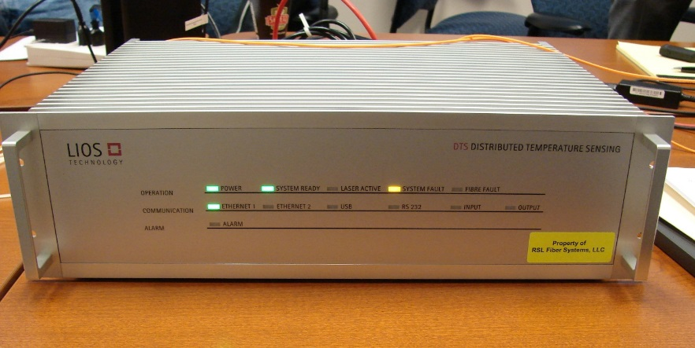
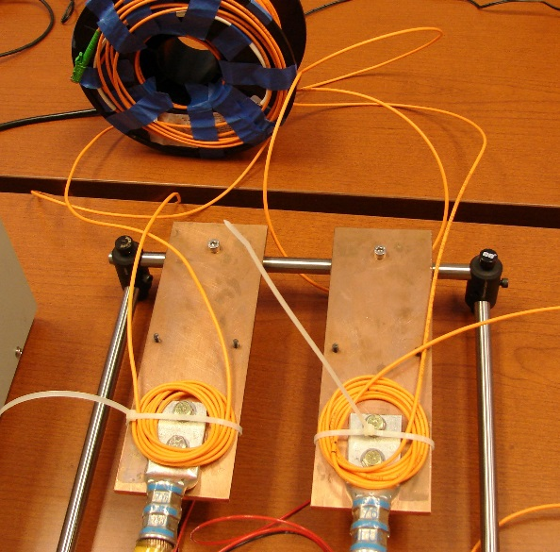
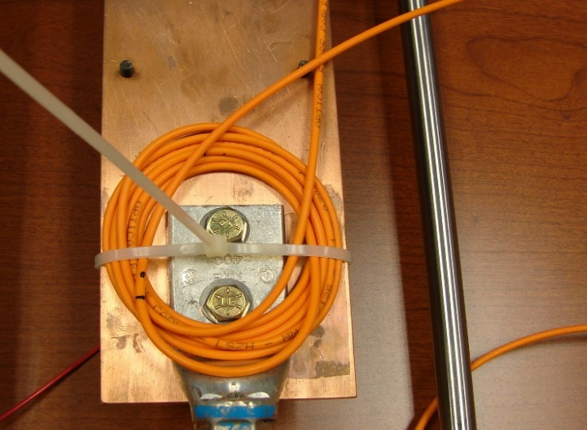
Benchtop Demo Raman
RSL
RSL (Lios) Interrogator Front
RSL (Lios) Interrogator Rear
RSL Fiber Sensor on Penn State Test Rig
Close up of Raman Sensor Coil
Distribution Statement A: Approved for public release: distribution unlimited

Slide 43
Benchtop Demo Raman
RSL Summary
Rack mount ruggedized interrogator, power consumption unknown. A sixteen channel interrogator is available.
Sensing uses regular jacketed multimode fiber that plugs directly into interrogator.
Spatial resolution for measurement along fiber is 50 cm. Measurements require a 2 m+ coil of fiber at each measurement point to get a good measurement.
Coils will need to be pre-made for practical installation in industrial environment
Maximum fiber length is 30 km, much more than needed for shipboard application.
Measurements can be averaged along fiber
Demonstration had difficulties with EOC test rig. There is a thermal lag in heat transfer from the measurement surface to all portions of the coil where the measurement is being made. Vendor looking into methods for mitigation
Distribution Statement A: Approved for public release: distribution unlimited

