Slide 1
NSRP Standardized Welding Curriculum and Testing for Shipyards
S. Scholler and T. Ringer

Slide 2
Why are you here?
Despite its advantages of being an economical way to join metal parts, inadequate fitting and welding can lead to structural problems such as distortion. Rework is necessary to remove distortion, which results in additional costs in manpower and materials. Additionally, rework leads to project time delays.
As a shipbuilder, it is important for you to understand:
structural problems and their associated costs
best practice methods to avoid problems such as distortion
how to correct distortion when it cannot be avoided
Notes:
Instructor:
QUESTION FOR CLASS: What are some problems associated with distortion?
* Write Class Responses on Board*
Despite its advantages of being an economical way to join plate, welding can lead to structural problems and rework such as distortion.
This module is designed to give you an understanding of welding induced problems on thin plate and the impact on cost and schedule.

Slide 3
Why are you here?
The main topic of this course is distortion control.
It is critical to your job knowledge and the quality of our ships.
The goal of this course is to aid you in understanding what distortion is and how to help control and reduce it.
Notes:
Instructor:
a) Of the many problems encountered when welding thin steel, this module will focus on distortion and distortion control
b) The ultimate goal will be to give you an understanding of distortion and what you can do to control the problem

Slide 4
Modern Design Construction of Naval Surface Combatants
Thin steel hulls have become a standard in Naval Surface Combatant designs
  Incorporates thinner and higher strength steel panels and structures
  Designs increasingly becoming more light weight to increase mission capabilities
  Meet operational objectives and improve vessel performance
  Counteracts increase in weight due to automated equipment and weaponry
  Naval vessels will increasingly trend toward use of thinner, light weight/higher strength steel designs
Notes:
Instructor:
a) Naval ship designs have become significantly lighter in recent years and will continue to trend towards thinner steel structures
b) To counteract the increase in weight needed for advanced weaponry and automated equipment, plate weight needed to be reduced to maintain mission capability

Slide 5
Modern Design Construction of Naval Surface Combatants
Thin steel designs create new challenging production environment and fabrication difficulties such as:
  Distortion due to high heat input on thin steel
    From traditional ship production processes
  Panel shrinkage and dimensional control issues
  Workforce unfamiliarity with techniques needed to ease construction difficulties
Notes:
Instructor:
a) Thin steel designs cause fabrication difficulties
Distortion from high heat
Panel shrinkage
Lack of training on new techniques

Slide 6
Distortion and Issues with Thin Steel
Distortion can be caused by almost every manufacturing process. This course will focus on distortion caused by locked-in residual (or left over) stresses that can come from four major sources:
  Steel mills rolling process, material handling, shipping and storage
  Poor fit-up caused by inadequate nesting (Engineering) and inaccurate cutting
  Over-welding, inadequate welding process and erection sequences
  Unrestrained, inadequate clamping and fixturing
Notes:
Instructor:
Distortion caused by residual stress.
“Left-over” stress
Builds up during manufacturing processes
Often cannot be seen by the eye
Residual stress Induced by
Steel mills
Poor fit-up
Overwelding
Lack of constraint (clamping) while welding

Slide 7
Distortion and Issues with Thin Steel
Thin steel is difficult to weld because it is more prone to buckling distortion as plate thickness decreases
Flame straightening is commonly used to remove distortion
Improper flame straightening has been found as the triggering mechanism for damage to many hull structures in NSC, LPD, DDG and LHD contracts
Over heating could lead to crippled structures!
Notes:
Instructor:
a) Easier to distort as plate thickness decreases
Costly repairs required late in construction
Repairs can cause further damage if distortion is excessive

Slide 8
Course Lesson Plan
Day 1: First Time Quality
    Cost of Rework and Process Delays
Day 2: Basic Welding Concepts
    Weld Joint Designs, Weld Sizes, Introduction to Distortion
Day 3: Welding Distortion
    Manual and Semi-Automatic Welding, Clamping, Tractor Welding, Pipe Welding, Tacking
Day 4: Shipfitting and Insert Fitting/Welding
    Layout, plate and insert fitting and welding, root gaps
Day 5: Mockup Activities
Notes:
Instructor: This is a recommended breakdown of the course

Slide 9
Introduction
Module 1

Slide 10
Topics
What is Residual Stress?
What does quality mean?

Slide 11
Objectives
After this module, you will be able to:
  Explain why it is important to learn about welding distortion
  Discuss why quality is important
This is how:
  We shall discuss why quality is important through class discussion and by watching a short video clip

Slide 12
Is 99.9% Called Success?
First Time Quality (FTQ): What does it mean?
Things done right the first time!
The result of FTQ is companies can better identify methods and processes to streamline production to ensure a higher quality product in a more cost-efficient manner.

Slide 13
What is First Time Quality?
FTQ can further be defined as a lean metric that indicates to what extent work is done correctly the first time without need for costly rework or replacement
FTQ is an important tool in any Quality Management System toolbox to deliver a high quality product— built right, the first time
FTQ is a key element in the effort to exceed the expectations of both internal and external customers

Slide 14
What is First Time Quality?
A well-strategized FTQ system offers a multitude of benefits, including:
  the ability to identify opportunities for continuous improvement
  reducing costs
  providing added value to customers by demonstrating and documenting measurable performance
  Providing guidance on training shipbuilders in order to have the highest probability of success based on demonstrated FTQ history

Slide 15
What is First Time Quality?
How success is measured means different things to different people.
Is 99.9 percent good enough? It sounds good, but is it good enough when lives are at risk?
The number of welds in a Navy vessel would be overwhelming to try to count. The quality of those welds is vital to the safety of the vessel and its crew therefore we must strive to produce the best and safest vessel possible.

Slide 16

Why is Quality Important?
Video
Notes:
Group discussion: What do you think the correlation is between this slide and quality?

Slide 17
Group Activity
Read the case study of the USS Thresher in your workbook.
Prepare for Case Discussion:
What are some of the factors that may have led to this disaster?
What best welding practices would have aided in eliminating the problems leading up to this disaster?

Slide 18
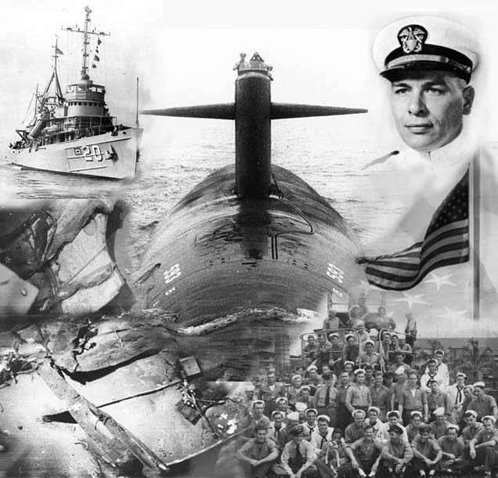
What is First Time Quality?
Was a 99.9 percent
FTQ rate considered
successful?
Absolutely not!
The work we do as
shipbuilders requires we
strive for a FTQ of 100 percent
EVERY TIME.

Slide 19
What is First Time Quality?
Welders are responsible for his/her work, not the foreman or QA inspector
Achieving FTQ and taking ownership of the quality of work you perform not only affects your workstation, but is amplified on every following workstation
Poor quality “snowballs” as the work moves downstream. Ensuring a quality end product starts with YOU!

Slide 20

It’s Not a Test!
We just want to establish the knowledge level of the class in order to tailor the course better to meet the needs of the participants.
Notes:
Instructor: Interactive Class Activity Opportunity.
Divide the students in groups of two or three.
Provide each group with a page from a flip chart taped to the wall.
Instruct the students to work in their small groups to answer the questions you ask.
Have the students write the number 100 on their flip chart paper. This represents the 100% each group is starting off with on the pre-assessment.
(5) Ask the first question from the pre-assessment.
(6) Have each group answer it to the best of their ability.
(7) Go onto the 2nd question and repeat for each of the subsequent questions.
(8) Once you have completed the questions, begin reviewing with the students by having each group share their responses and evaluate their answers.
(9) Determine if they have the question answered correctly. If they answered correctly, have them write 10 next to the question number. If they answered incorrectly, have them write 0 next to the question number
(10) Go onto the 2nd question, repeat the process for each of the subsequent questions. This process should be followed until you finish.
This activity provides the students with an interactive activity that will allow you to evaluate the level of knowledge of the class as a whole.

Slide 21
It’s Not a Test!
T
1._______ As a shipbuilder, it is important for you to understand structural problems,
their associated costs, best practice methods to avoid problems
such as distortion, and how to correct it when it cannot be avoided.
2._______ Naval Surface Combatant designs are moving away from thin panel designs
because they are weaker structurally but the transition will take several
years so we must continue to work with thin panel and distortion.
F
F
3._______ We should never set a quality goal that cannot be reached by all shipbuilders.
Notes:
Instructor: Interactive Class Activity Opportunity.
Divide the students in groups of two or three.
Provide each group with a page from a flip chart taped to the wall.
Instruct the students to work in their small groups to answer the questions you ask.
Have the students write the number 100 on their flip chart paper. This represents the 100% each group is starting off with on the pre-assessment.
(5) Ask the first question from the pre-assessment.
(6) Have each group answer it to the best of their ability.
(7) Go onto the 2nd question and repeat for each of the subsequent questions.
(8) Once you have completed the questions, begin reviewing with the students by having each group share their responses and evaluate their answers.
(9) Determine if they have the question answered correctly. If they answered correctly, have them write 10 next to the question number. If they answered incorrectly, have them write 0 next to the question number
(10) Go onto the 2nd question, repeat the process for each of the subsequent questions. This process should be followed until you finish.
This activity provides the students with an interactive activity that will allow you to evaluate the level of knowledge of the class as a whole.

Slide 22
It’s Not a Test!
T
4. _______ Welders and shipfitters should follow the specifications given by the designer as closely as possible so the overall project is successful.
F
5._______ The size and type of weld is determined by the welder after he/she evaluates the work to be done.
6._______ Weld size and joint designs do not affect the project cost but impact the structural integrity of the ship.
F
T
7._______ Each additional welded pass adds additional heat and creates slight material degradation.
Notes:
Instructor: Interactive Class Activity Opportunity.
Divide the students in groups of two or three.
Provide each group with a page from a flip chart taped to the wall.
Instruct the students to work in their small groups to answer the questions you ask.
Have the students write the number 100 on their flip chart paper. This represents the 100% each group is starting off with on the pre-assessment.
(5) Ask the first question from the pre-assessment.
(6) Have each group answer it to the best of their ability.
(7) Go onto the 2nd question and repeat for each of the subsequent questions.
(8) Once you have completed the questions, begin reviewing with the students by having each group share their responses and evaluate their answers.
(9) Determine if they have the question answered correctly. If they answered correctly, have them write 10 next to the question number. If they answered incorrectly, have them write 0 next to the question number
(10) Go onto the 2nd question, repeat the process for each of the subsequent questions. This process should be followed until you finish.
This activity provides the students with an interactive activity that will allow you to evaluate the level of knowledge of the class as a whole.

Slide 23
It’s Not a Test!
F
8. _______ Residual stress is the stress that can be removed through the flame straightening method of distortion control.
F
9._______ Fillet weld gauges are used only by the foremen and quality inspectors to check the angle of the weld.
10._______ The root cause of welding distortion is high heat input.
T
Notes:
Instructor: Interactive Class Activity Opportunity.
Divide the students in groups of two or three.
Provide each group with a page from a flip chart taped to the wall.
Instruct the students to work in their small groups to answer the questions you ask.
Have the students write the number 100 on their flip chart paper. This represents the 100% each group is starting off with on the pre-assessment.
(5) Ask the first question from the pre-assessment.
(6) Have each group answer it to the best of their ability.
(7) Go onto the 2nd question and repeat for each of the subsequent questions.
(8) Once you have completed the questions, begin reviewing with the students by having each group share their responses and evaluate their answers.
(9) Determine if they have the question answered correctly. If they answered correctly, have them write 10 next to the question number. If they answered incorrectly, have them write 0 next to the question number
(10) Go onto the 2nd question, repeat the process for each of the subsequent questions. This process should be followed until you finish.
This activity provides the students with an interactive activity that will allow you to evaluate the level of knowledge of the class as a whole.

Slide 24

Take a 10 minute break!
Notes:
Instructor: Use this slide to set the breaks for your class.

Slide 25
Welding
Module 2

Slide 26
Topics
Weld Sizes: Is Bigger Better?
Overwelding vs. Underwelding
Welding Distortion
Problems with Building Welds on Poor Quality Tacks
Manual/Semi-Automatic Welding
Track Welding
Pipe Welding
Tacking

Slide 27
Objectives
After this module, you will be able to:
  Define distortion control and explain how it applies to shipbuilding
This is how:
  We shall discuss the affects of distorted material
  We shall explain the importance of distortion control
  We shall identify the five (5) specific types of weld distortion
  We shall discuss the process of distortion control
Notes:
Instructor:
a) After course, you should have better understanding of distortion, how it’s caused, and ways to minimize its effects
Achieved by
Overview of distortion and different types
Explain distortion control

Slide 28
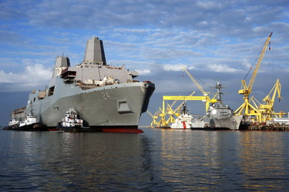
Importance of Welding
Why is welding important?
Notes:
Instructor: Open class discussion by asking them why they think welding is important.

Slide 29
Weld Size: Is Bigger Better?
It is easier for designers to see the whole picture whereas welders and shipfitters normally only see the area in which they are working.
Therefore, in designing welded connections designers should consider the work necessary for the shipfitter and the welder as well as specify the amount and size of weld actually required per design specifications.
Welders and shipfitters should follow the engineering drawings and instructions as closely as possible so the overall project is successful and meets expected financial goals. This is important for the company and competition for future work.
Notes:
Instructor:
Designers need to consider production impact when sizing welds, tendency to overdesign
Designers have the opportunity to see the ship design as a whole so they need to do a better job at designing for production

Slide 30
Weld Size: Is Bigger Better?
Almost any weld can be made in any material in any position. A number of factors can affect the cost of producing a weld. Welding to the design specified size is one major way to control welding cost.
Reducing the groove angle can decrease the welding filler metal required to complete the weld as well as decrease the time required to fill the larger groove opening.

Slide 31
Weld Size: Is Bigger Better?
On thin material, smaller welds can actually have increased strength because the weld cools faster which means harder weld metal in higher strength
Overwelding on thin plate or creating an additional pass adds heat and distortion without improving the strength of the plate
Notes:
Instructor:
a) Smaller welds have increased strength per area due to quicker cooling rates
Small weld callouts (3-5mm) generally welded on thin member structurals where full weld penetration is often achieved
Overwelding adds no strength to weld joints
Additional heat from larger welds only damages material properties and adds unnecessary residual stress into the plate

Slide 32
Overwelding vs. Underwelding
Overwelding and under welding each present their own set of problems. In the following section, we will examine both and their overall effects on the cost and quality of the project.
Despite common belief by some that more is better, the cost of over and under welding both add non-valve as time and labor are drastically impacted. Labor is the most significant of the cost.
Cumulative Fillet Weld Time (hrs) Based on 100ft of Weld
Weld Size | Weld Passes | Flat (16 ft/hr) | Vertical (8 ft/hr) | Overhead (4 ft/hr)
3/16” | 1 | 6.25 | 12.5 | 25
3/8” | 2 | 13.5 | 27 | 54
5/8” | 3 | 20.5 | 41.5 | 83
Note: Weld prep for additional pass ≈ 15% weld time
Notes:
Instructor:
Overwelding and underwelding both create unnecessary non-value added time
Overwelding is a greater concern due to the distortion and associated rework it requires late in construction
Welders are pushed to overweld by QA based on undersized weld restrictions
Overwelding increases labor cost, distortion, rework, and can harm the overall weld strength

Slide 33
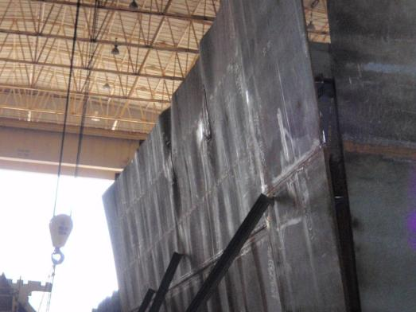
Weld Distortion
What is weld distortion?
The alteration of the design shape (or other characteristic) of an object
What is distortion control?
The process of controlling the potential distortion in an object, such as distortion in a weldment caused by welding
Inserts
Notes:
Instructor: Ask class - what do you see in this picture? What is the problem?
Explain: The picture here shows distortion of the material. The Distortion Control program is designed to remove the distortion
through various methods and straighten out the material for installation on the ship.
This process can further be defined as the elimination or reduction of
distortion in an assembly, unit, or ship

Slide 34
Weld Distortion
What is residual stress?
Stress that remains after the original cause of the stresses has been removed.
Due to the moving heat of a welding arc, the plate heats and cools at different rates in certain areas, leaving residual stresses in the material
Distortion is closely related to the amount of residual stress and the degree of joint restraint during the welding process
Notes:
Instructor:
A major contributor to welding distortion is residual stress
Stress that remains after a manufacturing step
Cannot be seen
Is an unknown quantity
Induced by welding

Slide 35
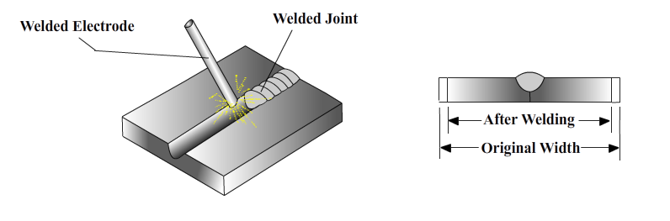
Weld Distortion
What causes distortion?
As welding heats the material, joints fuse together causing a highly localized heated area. This results in non-uniform stresses setting up in the material because of the expansion and contraction of the heated material
Notes:
Instructor:
Distortion from welding is caused by high heat input in a localized area
This causes non-uniform stresses in the plate when expansion and contraction occur
Plate can move out-of-plane to rebalance stresses which causes distortion

Slide 36
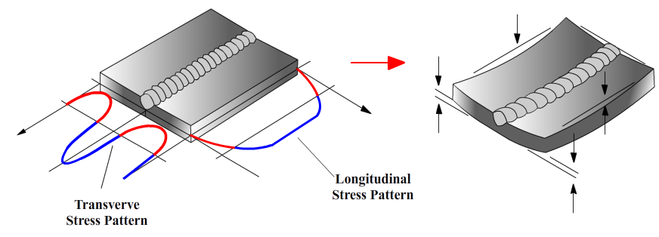
Weld Distortion
What causes distortion?
Initially, stresses are created in the surrounding cold metal when the weld pool is formed as the heat affected zone (HAZ) next to the weld pool expands. Additional stresses occur during the contraction of the weld metal and the cooling of the HAZ is resisted by the bulk of the cold metal.
Notes:
Instructor:
These graphics illustrate how stress from welding heat can cause distortion
Blue areas on graph show tension zones in the plate induced by heat
Red areas show compression zones which occur on the cooler areas of the plate outside the HAZ
As stresses rebalance while the weld cools, the compression zones resist the steal in tension from contracting uniformly and forces plate to move upwards and distort.

Slide 37
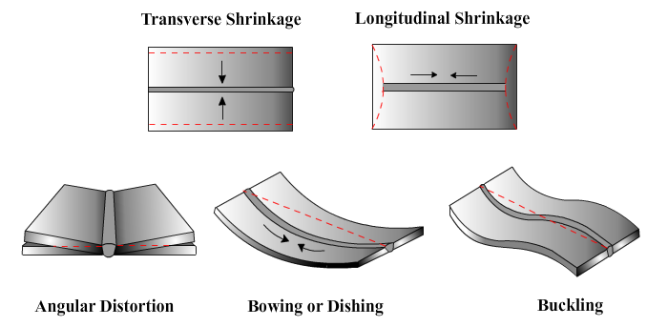
Types of Distortion
There are five forms of distortion. Two or more types of distortion may occur at the same time.
The types of distortion are:
  Transverse shrinkage
  Longitudinal shrinkage
  Angular distortion
  Bowing and dishing
  Buckling

Slide 38
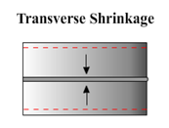
  Transverse Shrinkage
What causes transverse shrinkage?
  The majority of transverse shrinkage is caused by welding in the longitudinal direction
  This type of distortion is primarily dependent on the cross-sectional area of the joint.
  The bigger the weld, the greater the shrinkage
Notes:
Instructor:
Heat from welding causes the plate to expand initially while hot and as it cools it contracts more than it’s initial size.
The amount of transverse shrinkage is dependent mostly on the cross-sectional area of the plate being welded, hence thinner material is more susceptible to increased plate shrinkage

Slide 39
  Transverse Shrinkage
What prevention measures can be taken?
  Lower heat input (reduce weld size, increase travel speed) will reduce the amount of shrinkage
  Cannot be totally avoided but it isn’t necessary bad if it is controlled
  Balanced heat input using recommended weld sequences
Notes:
Instructor:
Due to the nature of welding, there will always be heat put into the plate and some material shrinkage will always occur.
The key is to control the shrinkage and prevent non-uniform plate movement
Lower heat input from smaller welds or welds closer to design size
Balanced heat input and following weld sequences
Clamping resists out-of-plane plate movement and forces the plate to shrink horizontally

Slide 40
  Transverse Shrinkage
What correction measures are necessary?
  If the amount of shrinkage exceeds the amount of stock left to account for shrinkage, costly rework may be necessary
  If the overall dimensions are shorter than the design tolerance, weld buttering (cladding) may be needed to make up the gap difference
  Severe cases may require insert pieces added at the end joint, often late in construction
Goal for controlling shrinkage
  Achieve “Neat Construction.” Account for shrinkage values and avoid the need to add and trim excess stock
  These corrections are extremely costly and decrease quality
Notes:
Instructor:
a) If plate shrinks out of dimensional tolerance, costly repairs may be required
a) Difficulty fitting plate
b) May force weld “buttering” when fitting EJ’s
C) If too severe, an insert plate may be needed to make up dimensional shortages

Slide 41
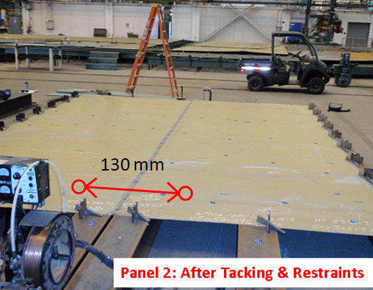
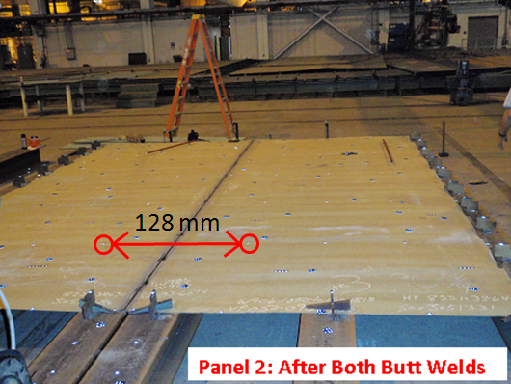
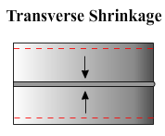
  Transverse Shrinkage
After Seam Fitting and Tack Welds
After Seam Welding
2 mm transverse shrinkage across longitudinal seam after welding
(Welded with double sided SAW tractor)

Slide 42
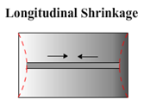
  Longitudinal Shrinkage
What causes longitudinal shrinkage?
  Majority of longitudinal shrinkage is shrinkage along the length of the weld
  Shrinkage that occurs parallel with the weld
  This type of weld distortion is dependent on the length as well as the cross sectional area of the plate structure
Notes:
Instructor:
Longitudinal shrinkage is nearly identical to transverse shrinkage but in the longitudinal direction
Shrinkage along the length of the weld
Amount of longitudinal shrinkage dependent on the length of weld AS WELL as cross-sectional area of the weld and plate

Slide 43
  Longitudinal Shrinkage
What prevention measures can be taken?
  Lower heat input (reduce weld size, increase travel speed) will reduce the amount of shrinkage
  Cannot be totally avoided but can be controlled
  Balanced heat input using recommended weld sequences
Notes:
Instructor:
a) Same prevention measures as transverse shrinkage

Slide 44
  Longitudinal Shrinkage
What correction measures are necessary?
  If the amount of shrinkage exceeds the amount of stock left to account for shrinkage, costly rework may be necessary
  If the overall dimensions are shorter than the design tolerance, weld buttering (cladding) may be needed to make up the gap difference
  Severe cases may require insert pieces added at the end joint, often late in construction
Goal for controlling shrinkage
  Achieve “Neat Construction.” Account for shrinkage values and avoid the need to add and trim excess stock
  These corrections are extremely costly and decrease quality
Notes:
Instructor:
a) Same correction measures as transverse shrinkage

Slide 45
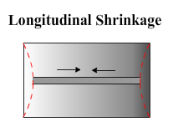
  Longitudinal Shrinkage
Notes:
Note: Must be in slideshow mode to view animation

Slide 46
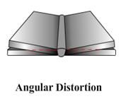
  Angular Distortion
What causes angular distortion?
  The weld cross-section is not balanced on the weldment perimeter causing features in the section to rotate with respect to each other
Notes:
Instructor:
Angular distortion is where the plate lifts up or bends down near the weld
Caused by unbalanced heat input
Example: When welding a butt where the top side pass penetrates roughly 75% through the thickness and no or minimal gouging is done on backside of plate. The second pass is likely to penetrate less than the first pass.
The movement from the heat input on the first pass is not matched or balanced on second pass and does not bring plate back flat.

Slide 47
  Angular Distortion
What prevention measures can be taken?
  Using tack welds to set up and maintain the joint gap
  Identical components welded in a sequence that is balanced about the neutral axis
  Process and technique should aim to deposit the weld metal as quickly as possible
  Use of proper clamping
Notes:
Instructor:
Prevention Measures
Maintain root gap
Weld components in a matter that balances heat across the neutral axis (Demonstrate with insert drawing)
Back-step welding to control plate movement

Slide 48
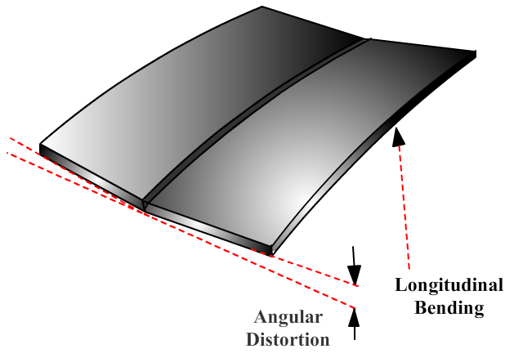
  Angular Distortion
What correction measures are necessary?
  Mechanical straightening by adding strongbacks or other supports where needed
  Flame straightening
Notes:
Instructor:
Inducing more heat via flame straightening to relax plate back to flat
Some forms of angular distortion such as rotational distortion (think insert welding) cannot be corrected since they are locked in after welding is completed.

Slide 49
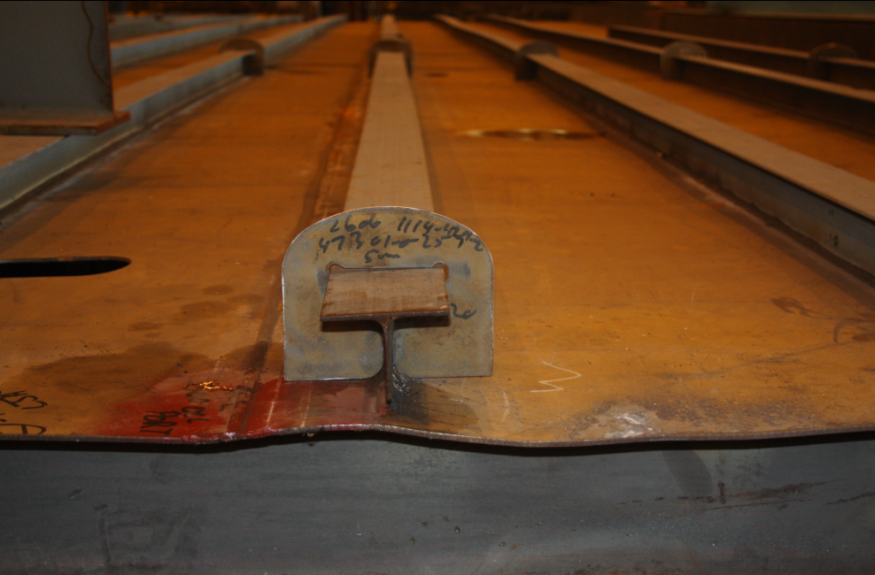
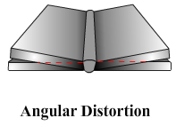
  Angular Distortion

Slide 50
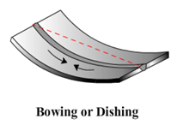
  Bowing Distortion
What causes bowing distortion?
  Bowing distortion occurs when the weld is not balanced with respect to the neutral axis of the cross section affecting the straightness of the weldment so that longitudinal shrinkage in the welds bends the section into a curved shape
Notes:
Instructor:
Bowing Distortion occurs when longitudinal shrinkage bends the plate into a curved shape or lifts the plate at the ends
Caused by
Unbalanced heat input
Lack of restraint or clamping to resist out-of-plane movement while cooling and rebalancing stresses

Slide 51
  Bowing Distortion
What prevention measures can be taken?
  Weld sequencing and back-step welding should be used to minimize bowing
  Adequate plate restraint prior to welding

Slide 52
  Bowing Distortion
What correction measures are necessary?
  Correction measures can be mechanical or thermal
    Mechanical is preferable when shrinkage from flame straightening is a concern. However, cracking formation need to be prevented
    Mechanical straightening requires using force (wedge, pneumatic ram, etc.) to push the bowing area flat and a strongback or header is welded to hold the panel flat when the force is released
    In the case of severe bowing on a T beam, the distortion needs to be corrected thermally with flame straightening as mechanically straightening it would cause a T beam to ripple and become unstable
Notes:
Instructor:
Correction measures
Mechanical (strongback)
Push the distortion out and weld a strongback to hold it in place
Used when over shrinking is a concern
Thermal
Some cases require thermal straightening as mechanically straightening would cause rippling

Slide 53
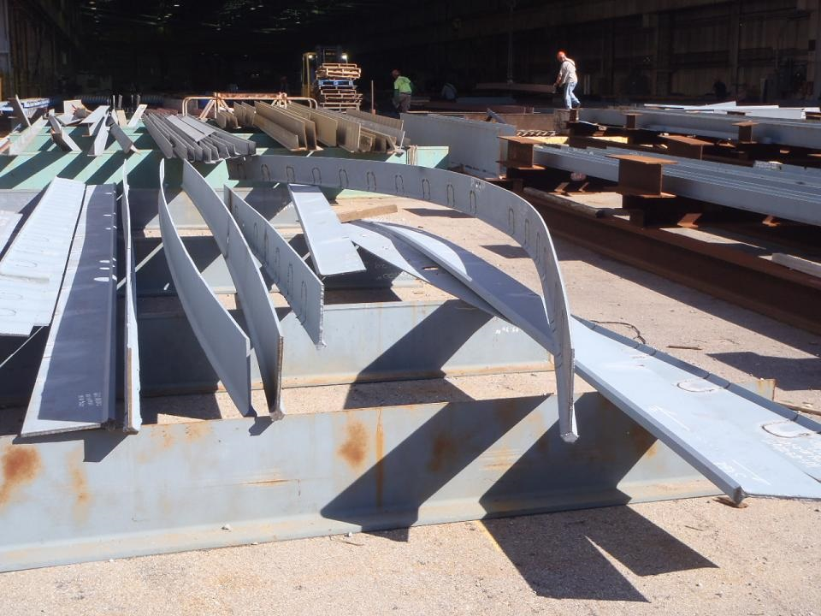
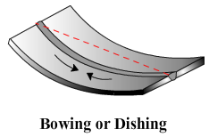
  Bowing and Dishing
Notes:
Instructor:
This shows an example of bowing on a bulb tee
Heat from splitting tee and beveling flange caused bowing

Slide 54
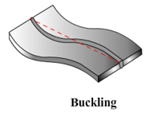
  Buckling Distortion
What causes buckling distortion?
  It is the most violent of the out-of-plane distortions
  Is extremely sensitive to initial stress conditions
  Buckling distortion is usually more prevalent in thin metal structures
Notes:
Instructor:
Buckling distortion is caused by unbalanced stresses in plate being released during welding heating and cooling
Extremely sensitive to initial stress level in plate
Example: forced-fitting insert into opening builds up stress that causes plate to move out-of-plane after welding
Thin plate more susceptible due to low buckling resistance in plate

Slide 55
  Buckling Distortion
What prevention measures can be taken?
  Following proper welding sequences (In general, weld steps should be progressed from the center of the work outward)
  Adequate clamps/restraints on the panel edge and near welding area PRIOR to welding
  Achieving proper fit-up to ensure weld size control and limit residual stress
  WELDING TO DESIGN SIZE
Notes:
Instructor:
Proper weld sequencing, moving from the center of the work piece outward
Pushes distortion to plate edge
Prevents distortion from being “locked-in” which can happen if perimeter pieces are welded before center pieces. Structurals on edge when welded prevents distortion from moving outboard.
Utilize adequate clamps prior to welding
Holds plate flat so distortion is not locked into plate when pieces are welded
Allows for natural in-plane shrinkage while resisting out-of-plane buckling
Weld to design size, don’t overweld!

Slide 56
  Buckling Distortion
What correction measures are necessary?
  Thermal (Flame Straightening) works by inducing additional heat into the steel to generate a shrinkage force that will pull the distortion out
  Displacement in buckling mode are not always repeatable, so rework is usually the necessary remedy
Notes:
Instructor:
Correction Measures Needed
Thermal Flame Straightening. Induces more heat into plate to generate shrinkage force that pulls the distortion out.
Buckling distortion is unstable and can pop up or down in different areas
Mechanical fixes generally won’t work because it will move the buckling somewhere else on the plate
Thermal straightening generally the only viable option

Slide 57
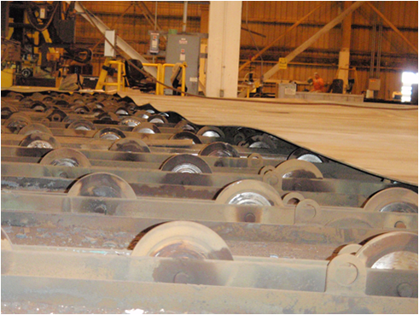
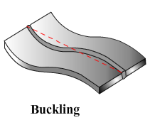
  Buckling Distortion

Slide 58
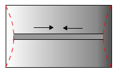

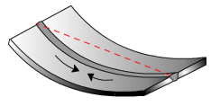
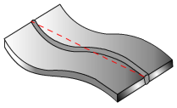
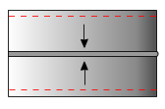
Knowledge Check
Bowing Distortion
Buckling Distortion
Longitudinal Shrinkage
Transverse Shrinkage
Angular Distortion
Notes:
Begin with the first picture and work down. Have the students select the appropriate corresponding box on the right describes the distortion in the picture. As you click the arrows with indicate correct answers.

Slide 59
Why is Distortion Control Important?
Employees taking a proactive approach to distortion control reduces production costs
Why would you say it is important to reduce costs?
Reduces
Rework
Reduces
Cost
Improves
Schedules
Notes:
Instructor:
Stress: It is important to maintain a proactive approach to distortion control. By ensuring you know your procedures and policies, you can avoid rework, excess costs, and delays to schedule.
Ask: Why would you say it is important to them to reduce costs?
There are no perfect answers. The design of this question is to get them thinking about reasons why saving money for the company is important .

Slide 60
Thin Steel Welding
Implementation Items
Increase fitter/welder communication and feedback:
Benefits:
  Increased final weld quality and part weldability
  Increased workmanship and accountability
  Remedy problems created by others that may unknowingly cause problems downstream
Notes:
Instructor:
Some easily implementable ideas to improve quality
Increase fitter/welder communication
Increases quality
Workmanship accountability – less finger pointing

Slide 61
Thin Steel Welding
Implementation Items
Increase welding automation:
Benefits:
  Superior weld quality, improved process time
  More consistent control of welding parameters
  Automated welding is generally faster than manual
Notes:
Instructor:
Increase Welding Automation
Better weld quality and process time
Consistent control of welding parameters

Slide 62
Thin Steel Welding
Implementation Items
Incorporate weld size into welder certification process:
Benefits:
  Incorporating a weld-to-design tolerance prior to being released to the field promotes a weld size conscious approach from the start
  MIL-STD-1628 Rev B will have an underweld tolerance and is awaiting final approval
Notes:
Instructor:
Require welder to certify in welding small sized welds prior to production work
Promotes weld size conscious approach
Affords the welder an opportunity to work with instructors on an approach to get smaller welds in difficult positions or processes

Slide 63
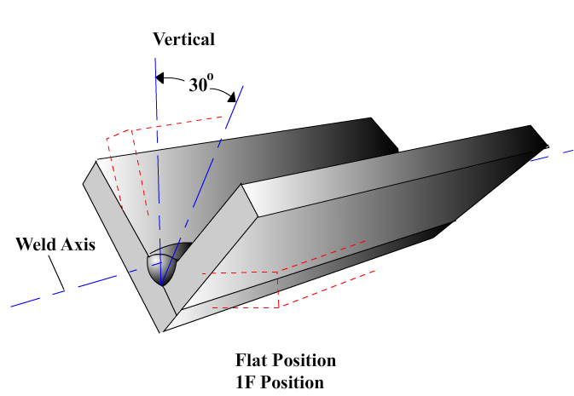
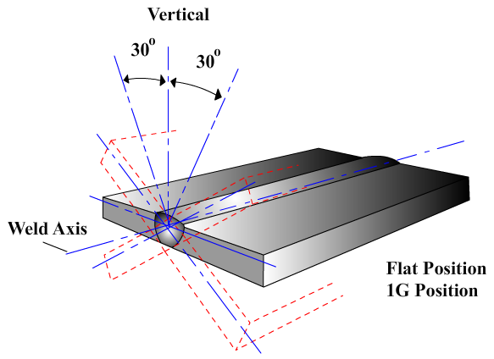
Weld Positions
There are four basic positions of welding that are employed in structural fabrication.
Flat position – used to weld from the upper side of the joint – the face of the weld is approximately horizontal.

Slide 64
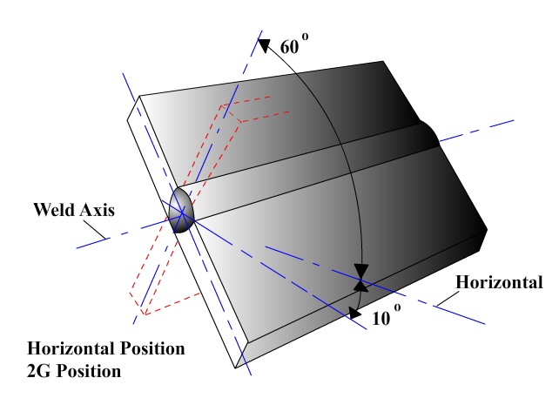
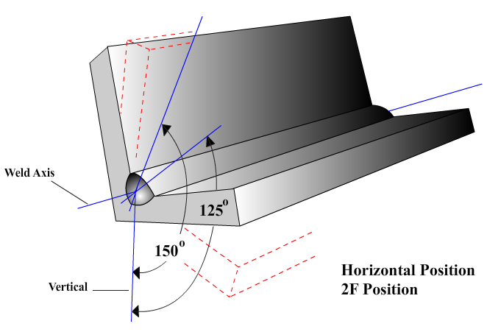
Weld Positions
Horizontal Position – used when welding is performed on the upper side of an approximately horizontal surface and against an approximately vertical surface.

Slide 65
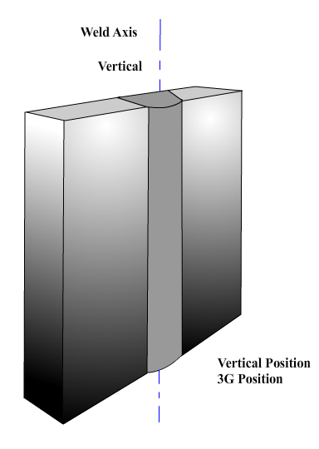
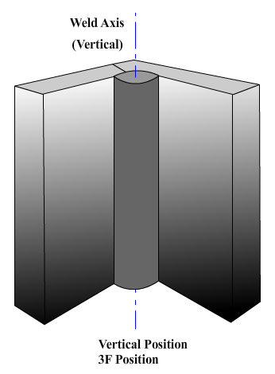
Weld Positions
Vertical Position – in structural welding, the position of welding in which the axis of the weld is approximately vertical.

Slide 66
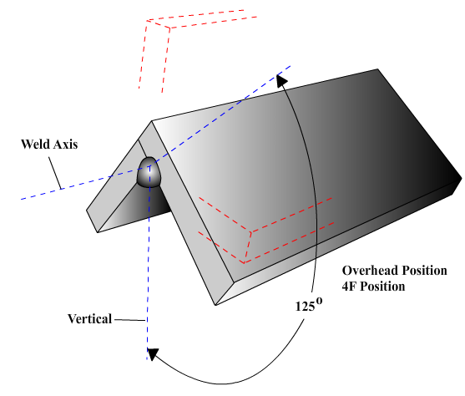
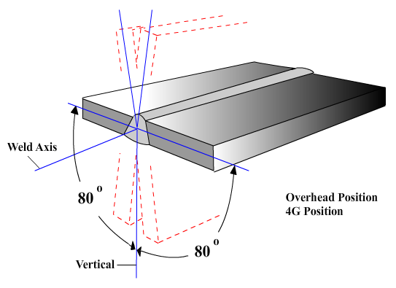
Weld Positions
Overhead Position – the position in which welding is performed from the underside of the joint

Slide 67
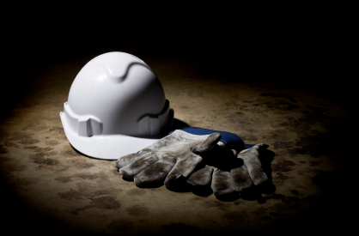
Which Welding Process to Use?
The type of weld process used is normally a decision made by the foreman but the welder should understand why a particular process was chosen.

Slide 68
Welding Processes
Manual welding processes include:
SMAW (stick welding)
GTAW (TIG) welding
Semi-automatic welding processes include:
GMAW (MIG)
Flux-Core
Machine Welding processes include:
Flux-core
Sub-arc welding (SAW)

Slide 69
Shielded Metal Arc (SMAW)
Advantages
Versatility – readily applied to a variety of applications and a wide choice of electrodes
Completely Manual
Low cost
Suitable for out-of-position
welding
Not very sensitive to
environmental conditions
Notes:
Instructor: This slide contains a animated swf file that doesn’t not always show up in the design mode of the presentation. It will show up in presentation mode. You may receive a warning message that reads “This document contains embedded content that may be harmful to your computer.” There are two options to choose from: “Do not allow content to play (Recommended).” and “ I recognize this content. Allow it to play.” You must choose the second option – “I recognize this content. Allow it to play” in order for animations to play. If you opt to not allow the content to play it will show a blank area on the slide but will allow you to advance through the presentation.

Slide 70
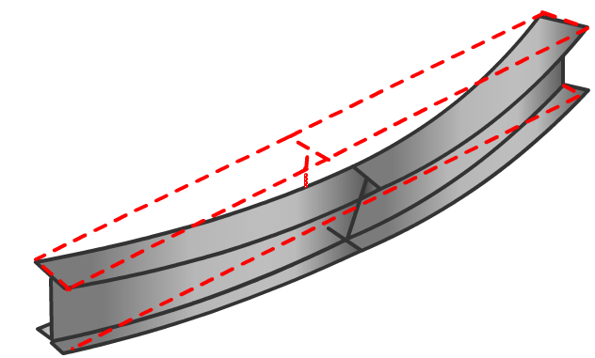
SMAW (Stick Welding)
Disadvantages
Welding thin materials may be difficult even for skilled welders
Many starts and stops for the length of weld
Slow travel speed will generate distorted members

Slide 71
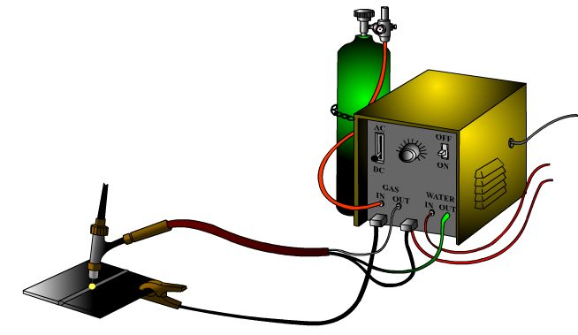
Gas Tungsten Arc (GTAW)
Advantages
Applicable to a very wide range of materials
Especially good for welding thin section pipes and sheetmetal applications
Capable of producing welds of high quality
and appearance

Slide 72
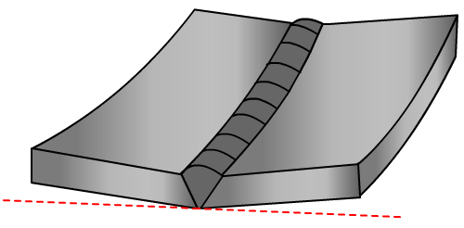
Gas Tungsten Arc (GTAW)
Disadvantages
Very slow travel speed
Very low deposition rate
Can generate large amounts of distortion if used for thicker parts

Slide 73
Gas Metal Arc Welding (GMAW)
  Advantages
  Higher productivity due to time saved by not having to constantly change electrodes or chip away slag
  Clean and efficient
  Versatile
  Faster Welding Speed
  than SAW or GMAW

Slide 74
GMAW (MIG Welding)
  Disadvantages
  Costly
  Limited positions fluidity of the welding puddle and the high heat rule it out for vertical and overhead welding
  Unsuitable for outdoor welding
  Fast cooling rates since not covered by slag

Slide 75
FCAW (Flux-core)
  Advantages
  Versatility – suitable for a variety of positions and applications
  Enables “one process” operation for individual projects – simplifies training, supervision and logistics
Capable of relatively
high deposition

Slide 76
FCAW Process
  Disadvantages
  Incorrect selection of consumables and parameters may lead to lower weld toughness
  Fume extraction may be required

Slide 77
Common Problems
Common Manual/Semi-Automatic problems
Overwelding
Weld Gauge Use and Misuse
Proper Welding and Equipment Adjustments

Slide 78
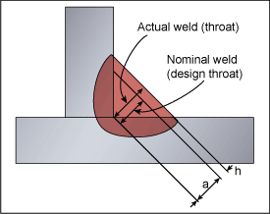
Over Welding
Common causes are:
Poor fit quality
High welding current
Slow travel speeds
Some are supervision related (e.g. ‘to be safe make this fillet weld bigger by x mm’)
Avoidance:
Adhere to the specified welding procedure and parameters
Do not add to the specified weld size
Where possible use automated welding processes
Notes:
Correct a and h

Slide 79
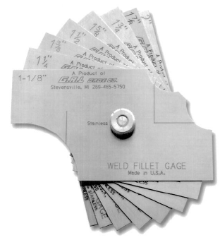
Measuring Tools
The fillet weld gauge is one of the most often used measuring devices to measure the throat and leg of a fillet weld
The size of the actual weld is checked by using one or more gauges to compare the size of the weld to the size of the individual gauges.
It is commonly used incorrectly
Video
Leaf Style Fillet Gauge
Notes:
Instructor Note: Explain to the students the difference in sizing the weld and measuring it. Leaf style gauges only indicate whether the weld is less than, larger than, or the same size as the gauge.

Slide 80
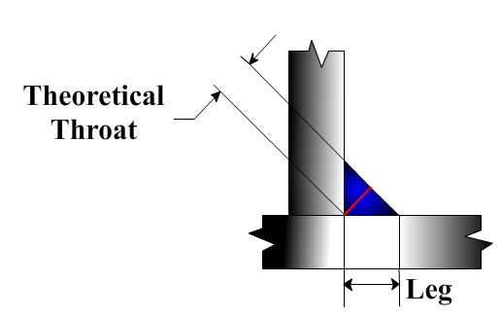
Measuring Tools
Fillet welds have a cross section that is essentially a triangle.
If the two members being joined are at right angles to each other, the cross section of the fillet weld resembles a right triangle
When possible the fillet weld gauge should be read at eye level as size readings look different depending on the angle at which they are being read.
Notes:
Instructor Note: Give an example of the gauge looking different by allowing students to read the gauge at different angles.

Slide 81
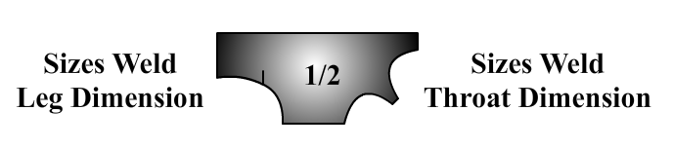
Measuring Tools
A leaf style fillet weld gauge is commonly used to measure the size of the fillet weld
Leaf style fillet weld gauges typically come in 1/16 inch increments for weld sizes 1/2 inch and smaller, and in 1/8 inch increments for sizes 5/8 inch and larger
The basic leaf style fillet gauge has two ends, one for sizing the weld leg and the other for sizing the throat (based on the equivalent leg size for the right triangle)

Slide 82
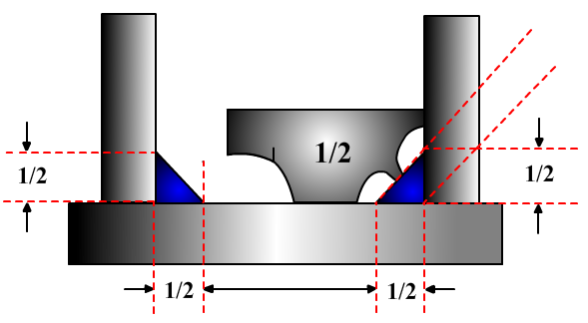
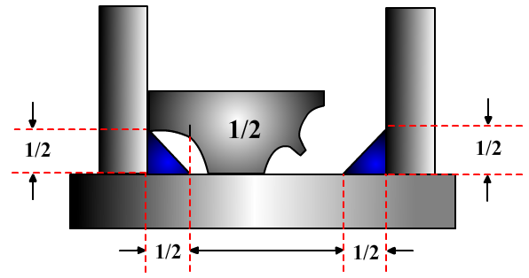
Measuring Tools
For this example, ideally both the weld legs would be exactly 1/2 inch while the throat would measure exactly 0.354 inch. The manufacturers print 1/2 inch on the right end of the gauge because the fillet throat is the proper size for a fillet weld with 1/2 inch legs. That saves the time needed to calculate the required throat dimension for each leg dimension.

Slide 83
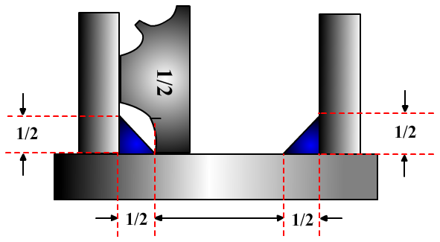
Measuring Tools
To measure a vertical fillet leg the gauge has to be turned to verify the horizontal fillet leg is the proper size.
Do not assume the two legs are the same size by design or as dictated by the welder’s skill, both horizontal and vertical legs must be checked.

Slide 84
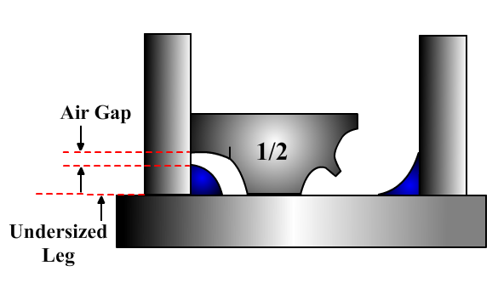
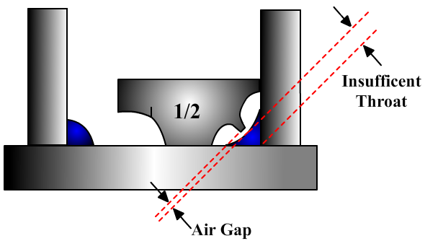
Measuring Tools
Checking the perfect weld is easy, but things get a little more complicated when dealing with fillet welds that are convex or concave or a combination of both.

Slide 85
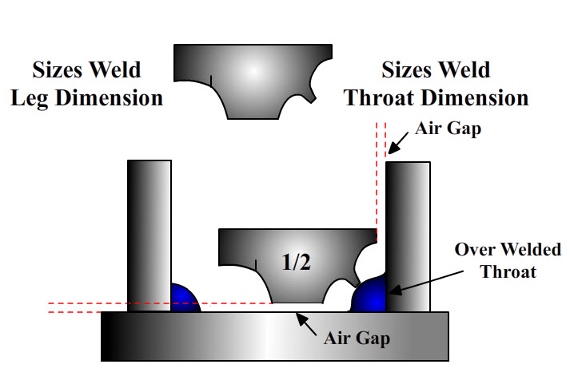
Measuring Tools
Welders should check for oversized welds and plan a way to reduce the amount of overwelding on future work. Oversized welds add no additional strength and can cause excessive rework.

Slide 86
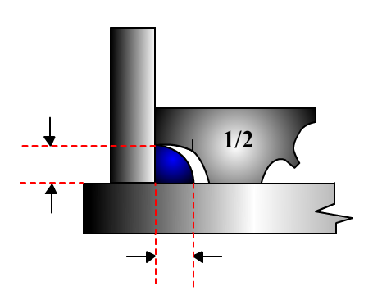
Knowledge Check
Would this convex fillet weld be considered good or bad?
If you said that it is a good
fillet weld you are correct.
Good Job!
Notes:
Instructor: Discuss why this is a good weld with the class

Slide 87
Proper Fillet Welding/Equipment Adjustments
Fillet Weld Size
SAW | 1/8” (3mm) | 3/16” (5mm) | 1/4” (6mm)
Current (Amps) | 330 | 330 | 330
Voltage (Volts) | 29 | 29 | 29
Travel Speed (in/min) | 48 | 32.5 | 30
PLEASE NOTE: These adjustments are only recommended as a base line for fillet welds.
Settings may differ depending on individual skills and different machines

Slide 88
Proper Fillet Welding/Equipment Adjustments
Fillet Weld Size
FCAW | 1/8” (3mm) | 3/16” (5mm) | 1/4” (6mm)
Current (Amps) | 205 | 205-210 | 210-220
Voltage (Volts) | 25 | 25 | 25-27
Travel Speed (in/min) | 37.5 | 16.5 | 13-14
PLEASE NOTE: These adjustments are only recommended as a base line for fillet welds.
Settings may differ depending on individual skills and different machines

Slide 89
Proper Fillet Welding/Equipment Adjustments
Fillet Weld Size
GMAW (Pulse) | 1/8” (3mm) | 3/16” (5mm) | 1/4” (6mm)
Current (Amps) | N/A | 200 | 200
Voltage (Volts) | N/A | 24 | 24
Travel Speed (in/min) | N/A | 19.5 | 13
PLEASE NOTE: These adjustments are only recommended as a base line for fillet welds.
Settings may differ depending on individual skills and different machines

Slide 90
Proper Fillet Welding/Equipment Adjustments
Fillet Weld Size
GMAW (Aluminum) | 1/8” (3mm) | 3/16” (5mm) | 1/4” (6mm)
Current (Amps) | 230 | 230 | 230
Voltage (Volts) | 23.5 | 23.5 | 23.7
Travel Speed (in/min) | 75 | 57 | 47
PLEASE NOTE: These adjustments are only recommended as a base line for fillet welds.
Settings may differ depending on individual skills and different machines

Slide 91
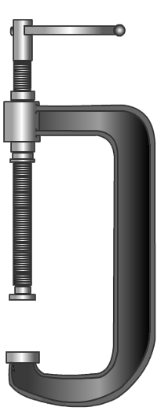
Clamping
Clamps should be placed as near the seams being welded as possible (ideally 2”)
The further away a clamp is placed from the weld, the less support it provides in resisting welding distortion
Notes:
Instructor:
Plate restraint through clamping is the most effective preventive measure in controlling distortion on thin plate
Should be placed as near weld area as possible
Resists out-of-plane movement while allowing natural in-plane shrinkage
Prevents already distorted areas from being locked into plate when structurals are welded

Slide 92

Clamping
Clamps placed around the plate perimeter will reduce the amount of edge distortion
Clamps should remain attached until the welded area and plate edges cool below 150° F or 20 min after the welding is completed
Notes:
Instructor:
Edge clamping maintains plate flatness through welding process
Most effective when placed at a distance equal to stiffener spacing
Clamps need to be applied PRIOR to any welding, and should remain until plate cools down after welding
If you need more clamps ASK! There is budget allocated to purchasing equipment for distortion reduction

Slide 93

Clamping
Without clamping this example of a tee beam is clearly distorted:
What type of distortion is this an example of?
Angular Distortion
Notes:
Instructor:
Modeling plate movement due to welding an unclamped beam shows a high magnitude of distortion

Slide 94


Clamping
Distortion is dramatically reduced when clamping is used properly
Notes:
Instructor:
When clamps are placed near the weld prior to welding and remain until plate is sufficiently cooled, the magnitude of distortion is drastically reduced.
In this example, clamping reduced the magnitude of out-plane-distortion by a factor of 7 on average along the length of the beam.

Slide 95

Clamping
Why did the clamping aid in controlling distortion?
Distortion was less due to a lower final residual stress
Notes:
Instructor:
Clamping reduced distortion because the plate was held flat during the heating and cooling of welding
The plate was not able to freely move in the Z direction when re-balancing internal stresses
The result is a lower final residual stress in the plate and therefore less distortion

Slide 96

Clamping
Clamps are used around the panel perimeter and along the edge of cutouts
Beam restraints are placed along the longitudinal seams prior to welding
Notes:
Instructor:
Here, clamping and heavy beam restraint use is shown during panel line construction.
On this deck, Accuracy Control distortion data was collected on this unit when clamping was used and on the previous hull when it was left unrestrained
Data showed that a 39% reduction in distortion after seam and insert welding was achieved

Slide 97

Structural Strong-Backs
  Use externally placed stud attached fairing tools to eliminate any welding and repair to outside shell
  Improved access/reduced clean up and reusable tooling
  Effective in most locations
Notes:
Instructor:
Strongbacks similar to what is used when fitting EJ’s can be used to prevent or repair distortion
When strong backs are used prior to welding, the buckling resistance and plate strength is greatly increased making it harder for the plate to buckle
Strongbacks can also be used as a corrective action for stable distortion.
Plate can be forced flat and a strongback is added to hold in in position
This mechanical fix is only successful when distortion is stable (i.e. not buckling)

Slide 98

Structural Strong-Backs
Example of Extensive Rework Needed
Strong back could not hold the plate at the hard frames
Plate puckered requiring back gouging of the weld and realignment of the plate
Notes:
Instructor:
Distortion causes continuous process delays and cost increases from the time it is first induced in plate
Each workstation after distortion is put into plate is forced to fight it and causes process delays
Process delays become increasingly cost prohibitive the later in construction a unit gets

Slide 99

Tractor Welding
What is tractor welding?
  Advantages
  Disadvantages
  Limitations
SAW Lincoln Electric LT-7 Tractor shown

Slide 100

Tractor Welding
What is tractor welding?
  Tractor welding uses a self-propelled mechanized wire fed tractor that is designed for the submerged arc process
  The tractor moves along sections of track that are easily moved to the area requiring welding

Slide 101

Tractor Welding
The proper settings used in tractor welding depends largely on the specific application
Welds butts, horizontal fillets and lap joints
On most tractors, the control box is mounted to the tractor eliminating the need to return to the power source for setting adjustments
Tracking control and self-steering in most applications allows the operator free for quality control, joint cleaning and flux handling
Lincoln Electric LT-7 Tractor Control Box
Video

Slide 102

Tractor Welding
Tractor welding reduces weld size, which results in decreased process time
The reduction of weld size and decrease of process time make increasing use of tracks for thin deck plate and large bulkhead applications a recommended practice

Slide 103
Tractor Welding
Common problems
Best suited in flat position but many tractors will weld up to 50 degrees on either side
Equipment and tracks can make clamping near a seam difficult
Proper fit-up required for minimizing root gap variance
There is an increased importance on clamping when using SAW tractors

Slide 104


Pipe Welding
Distortion caused by welding can seriously affect the alignment and location accuracy of a pipe installation unless preventive measures are taken to avoid potential problems
Without Distortion
Typical Fabrication
With Distortion

Slide 105


Pipe Welding
Common pipe welding problems include:
  Melt/Burn Throughs
  Ovality Issues
Melt/Burn Through
Ovality Issue

Slide 106
Pipe Welding - Melt/Burn Through
Melt/Burn Through
Occurs when puddle melts through to the inside of pipe due to excessive heat
Is caused by using too high amperage or too slow travel speed
Results in burn through with oxidation
Notes:
Instructor: Pass around sample of cut-away pipe showing melt/burn through.

Slide 107
Pipe Welding- Ovality/Alignment Issues
Ovality and Alignment Issues
Ovality in pipe can occur during the manufacturing process, which causes issues when fit to other members
Ovality can also occur during pipe bending
Notes:
Pass around sample of cut-away pipe, place picture of it here to discuss.

Slide 108
Pipe Welding- Ovality/Alignment Issues
Ovality and Alignment Issues
In the manufacturing process of pipe bends it is difficult to avoid:
  thinning on the internal side
  thickening on the external side
The cross section of the bend also becomes non-circular due to the bending process
As the pipe becomes non-circular, alignment issues arise when joining sections of pipe
Notes:
Pass around sample of cut-away pipe, place picture of it here to discuss.

Slide 109

Pipe Welding- Ovality Issue
Ovality is measured as the variation between the maximum and the minimum dimension of the pipe in one location
Formula for Ovality:
(A-B)/C = X maximum
Notes:
X = industry standard
A = maximum measurement
B = minimum measurement
C = nominal diameter
Notes:
Pass around sample of pipe with bad ovality issue.

Slide 110
Pipe Welding- Ovality Issue
The permissible variations for industry standards vary as does the size and types of pipe
Examples of some industry standards for steel or stainless steel are:
“Seamless and Welded – the minimum wall thickness at any point shall not be more than 12.5% under the nominal wall thickness specified.”
“Forged and Bored, and Cast – The inside diameter shall not vary under that specified by more than 1/16 in. There shall be no variation over the specified inside diameter.”
Formula for Ovality:
(A-B)/C = X maximum
Notes:
X = industry standard
A = maximum measurement
B = minimum measurement
C = nominal diameter
Be aware of the approved standards to which you work!
Notes:
Pass around sample of pipe with bad ovality issue.

Slide 111
Let’s Compare
Tacking and Temporary Welds
As stated by the American Welding Society (AWS),
Tacking is defined as "welds made to hold the parts of a weldment in proper alignment until the final welds are made“
Similar are "Temporary welds“ which are defined as welds "made to attach a piece or pieces to a weldment for temporary use in handling, shipping, or working on the weldments“
In both cases, one must remember these types of welds, if improperly made, may have negative influence on the quality of permanent welds

Slide 112
Tacking
It is very important to minimize the risks associated with poor tack welding as they must not interfere with or degrade the quality of the completed welded structure
Short tack welds require limited heat input which aids in minimizing distortion therefore it is better to have more short tacks than fewer long tacks
Tacks and temporary welds should be held to the same standards as permanent welds
Tack-welds, holding elements in place, must be easily removable for adjusting weldment construction

Slide 113

Tacking
It is prohibited to leave arc strikes as they can lead to failure of the material later on in the life of the ship
Tacks seen in this photograph are messy and not quality work

Slide 114

Tacking
Tack welds are commonly incorporated into the final weld therefore the tacker should always weld tacks with this in mind
Shown to the right are examples of good and bad tacks

Slide 115

Common Problem with Building Welds
on Poor Quality Tacks
Oversize tacks often drive an increase in weld size to cover tacks
Minimizing tack size eliminate overwelding and reduce welding induced distortion
Large tacks also make the use of semi-automatic equipment difficult causing longer process time and larger welds
Notes:
Correct the image. Back image shows welding over too large tacks

Slide 116

Common Problem with Building Welds
on Poor Quality Tacks
Fitter/Welders should never be permitted to check out two different types of electrodes but it is common for them to be allowed to check out different sizes of the same type of electrode and store them in the same can!
What can you see as a potential problem in this scenario?
Notes:
Instructor: Give a scenario of having a 7018 1/8” rod and a 7018 3/32” rod in the same can. Explain to the student that this is common and the welder/fitter knows they have both sizes and should make sure which size is called for in each application.

Slide 117
Knowledge Check
Why should the quality of a tack be the same quality of the final weld?
The tack should be the same quality of the final weld because the tack is made to be able to incorporate it into the final weld.

Slide 118
Knowledge Check
smaller
Tacks should be ___________ than the size of the final weld.

Slide 119
Knowledge Check
What are some of the disadvantages of tacks that are too large?
Large tacks result in added distortion to the unit
Large tacks create difficulty in using tractors to mechanically weld
Large tacks increase the need for repairs to be made using grinders

Slide 120
Knowledge Check
What two steps can be taken to retain the strength of a tack when using a 3/32 electrode?
Increase the length of the tack
Increase the frequency of the tacks

Slide 121
Knowledge Check
What must be done to all tacks before releasing a completed unit to the welding customer?
The slag must be removed from all tacks prior to release.

Slide 122

Distortion Correction
Spot Flame Straightening Method
The thin material is repaired using minimal propylene gas pressure, increased oxygen, and a #2 size torch tip.
The spot heating method is performed by creating 1- 1/4 inch spots along both sides of the weld seam and/or along both sides of the Tee’s.
Notes:
Instructor:
Distortion that remains out of tolerance is most often repaired using the thermal process of flame straightening
This process uses propylene gas to heat the plate and pull the distortion out as plate cools and contracts
Heat is applied to the structurals surrounding the distortion first and then spot heated between stiffeners as needed
Repaired late in construction generally after the majority of hot work is completed
Don’t want to risk straightening too early and having to redo if more distortion is created
Very costly and disruptive to compartment completion schedule

Slide 123

Distortion Correction
Repairing Excessive Heat Damage
This unit was repaired by creating 1-1/4 inch spots along the area damaged by excessive heat
The entire highlighted area was repaired using the spot heating method
When proper distortion control techniques are followed, this costly non-value added step can be minimized or eliminated
Notes:
Instructor:
Flame Straightening can lead to more rework and delays if distortion is severe
Paint is burned, other compartment work is halted, and in some cases thin membered structurals can be tripped.
If first time quality is achieved and proper distortion control techniques are used, this costly non-value added process can be avoided

Slide 124
Flame Straighten Example
Steps for Straightening 1/4” Plate
Step 1: Heat all stiffeners in a general area with distortion/deflection with a spot pattern
    1 to 1 ¼” spots 2” apart
    950 to 1000 degrees
    Stagger spots on each side of the stiffener
    Step 2: If unacceptable distortion/deflection still exists, repeat Step 1
    - Use an opposite spot pattern compared to Step 1
Notes:
Instructor:
Here is an example of the process used to flame straighten distortion out of plate
Process steps given are vague and rely mainly on operator experience and judgment
A non-thoroughly defined process like this has lead to significant damage and rework

Slide 125
Flame Straighten Example
Steps for Straightening 1/4” Plate
    Step 3: If unacceptable distortion/deflection still exists, line heat all stiffeners in a general area with distortion/ deflection with continuous running of the stiffener.
    Heat entire length of stiffeners
    950 to 1000 degrees
    Supervision should be notified prior to performing this step
Notes:
Instructor:
Due to the sensitivity of thin plate to react when high heat is applied, temperature control must be monitored closely
There are currently no guidelines to distinguish temperature differences for varying material grades and thicknesses

Slide 126
Flame Straighten Example
Steps for Straightening 1/4” Plate
Step 4: If unacceptable distortion/deflection still exists, heat distorted areas of the panel with spot pattern
    1 to 1 ¼” spots 2” apart
    950 to 1000 degrees
    Stagger spots between stiffeners, across the distorted areas of the panel
    Only high spots are to be heated to pull slack from the low spots
    Supervision should be notified prior to performing this step

Slide 127




After Repairs Using Heat Straightening
Notes:
Instructor:
These images show the flame straightening required to remove distortion caused by earlier processes
As you can see, the amount of heat required in some of these cases is excessive
Will require painting rework at a minimum and insert pieces if structurals are damaged

Slide 128
Shipfitting Plates and inserts
Module 3

Slide 129
Topics
Cutting and Fitting
Fit Quality
Plate/Insert Fit-Up and Welding
Back-Step Process

Slide 130
Objectives
After this module, you will be able to:
  Explain what is meant by fit quality
  Discuss proper plate/insert fit-up and welding
  Identify proper weld sequences and back gouging sequences
This is how:
  We will discuss fit quality and importance points to remember to ensure a quality fit
  Examine proper plate/insert fit-up and welding points
  Identify the proper weld sequence and back gouging procedures
Notes:
Instructor:
This module will:
Define fit quality and explain the importance it has on distortion control
Discuss proper insert fit-up and welding methods
Identify proper weld sequences and back-gouging techniques

Slide 131
Cutting and Fitting
Achieving proper fit-up for weld size control begins with the accuracy of parts coming off the cutting machines
Eliminating rework or process delays starts by accepting a quality product from the customer (internal or external)
Parts cut on the plasma cutters need to be properly nested by Engineering. All kerf and travel directions must be maintained per Engineering’s specifications
Notes:
Instructor:
The accuracy of the parts coming off the plasma tables is the first step to achieving proper fit-up for weld size control
Eliminating rework and achieving first time quality without process delays starts by accepting quality product from the customer, be it internal or external
Many groups effect the ability to achieve first time quality, engineering needs to properly nest parts and should be notified if there are process or equipment changes that could impact part accuracy.

Slide 132
Cutting and Fitting
Proper PM procedures for plasma cutters must be followed and any issues reported to your supervisor and maintenance
As a fitter, it is important that the part dimensions received are consistent with design specs and are checked before fitting
  Relay issues to a supervisor if a part is out of tolerance or if any inaccuracy trends are noticed
  Trimming MUST be done on insert plates that otherwise would create a forced-tight fit in order to maintain 1-2mm root opening
Notes:
Instructor:
Preventive Maintenance procedures for plasma cutters need to be followed to insure the plasma cutters are performing to the standard they were designed for.
Before fitting, it is important for fitters to check the part dimensions they receive and validate they are consistent with the design specs
If parts are continually out-of-tolerance, if any inaccuracy trends are noticed, or extensive trimming or other rework to fit properly are required, you should notify your supervisor so the problem can be identified and addressed at the root cause.
If insert plates are dimensionally inaccurate, it is essential that the plate is trimmed to maintain a 1-2 mm root opening before being welded
Under no circumstances should insert plates be forced-fit into decks as this causes a large buildup of residual stress and significant distortion will be created when the insert is welded.

Slide 133

Cutting and Fitting
Insert was forced-fit into deck plate (shown on radius)
There is no room for thermal expansion when welded, induces significant residual stress into plate
Distortion will radiate outwards from inserts fit this way and cause process delays and rework for every subsequent process
Notes:
Instructor:
This picture shows an insert plate that was forced fit into the deck along the radius
There is no room for thermal expansion when welded and residual stress is built up in the plate.
When the plate stresses rebalance after welding, the residual stress buildup will cause the plate to distort and the distortion will radiate outwards from the insert radii causing rework and process delays at every subsequent work station.

Slide 134

Cutting and Fitting
Poor Fit-up:
requires additional process time
Increases weld size
Can induce severe heat input and distortion if weld “buttering” is needed on excessive root gaps
Notes:
Instructor:
Poor fit-up causes a number of issues for welders and prohibits the use of proper distortion control techniques
It requires additional process time
Can increase the weld size required and lead to overwelding distortion
May require weld “buttering” which is a slow cumbersome process that can reduce the joint strength to lower than the design requires

Slide 135



Cutting and Fitting
Longitudinal Residual Stress in Plate Received from the Mill
Sequence I
#1
#2
Rolling
#2
Sequence II
#1
Notes:
Instructor:
Steel plate from the mill arrives at Ingalls with residual stresses already in the plate
Due to the nature of the material and the rolling process used, the residual stress in each plate is unknown and unique
Stress assumptions can be made and modeled to give a cutting process that minimizes plate movement and part inaccuracies
Following cut sequences in the nest tapes will allow for the best chance at receiving accurate parts

Slide 136
Cutting and Fitting
Effects of Edge Trimming on Residual Stress Re-Distribution
Notes:
Instructor:
Edge trimming of plate can relieve some of the inherent residual stress in the plate and allow for less distortion when fit and welded

Slide 137
Cutting and Fitting
Notes:
Instructor:
Here you can see the affects trimming has on relieving residual stress and controlling plate movement.
The dimensional changes have been exaggerated for clarity but are scaled to show actual differences between processes
When combined with an optimal cut sequence, part accuracy can be maximized.

Slide 138
Fit Quality
  Due to mill rolling procedures, residual stress is non-uniform
  Following the proper cut sequence will account for:
    The residual stresses
    Limit cutting inaccuracies
    Make proper fit quality easier to achieve
Notes:
Instructor:
As stated before, the mill rolling procedures cause non-uniform residual stress in the plate that makes each plate react different when cut and welded
Following the procedures laid out for you will minimize the uncertainties and improve quality

Slide 139

Fit Quality

Slide 140

Poor Fit-Up
Weld quality is driven by the fit quality
Overwelding and other rework are required when the fit quality is poor
Common causes of poor fit quality are:
Poor workmanship practice
Poor dimensioning
Tolerance dimensions on drawings
Notes:
Instructor:
Weld quality is driven by fit quality
Welding distortion control best practices are much easier to achieve when proper fit is achieved
Common causes of poor fit quality include:
Poor workmanship practice
Fit with excessive gaps or forced-fit insert
Excessive tack sizes
Poor quality tacks
Poor dimensioning
Tolerance on drawings

Slide 141

Poor Fit-Up
As seen here, the gap results in a reduction in the leg length and results in a reduction in the throat thickness of the joint
The fillet weld must then be increased to compensate for a large gap. This in turn adds to the amount of weld, which increases distortion.
Notes:
Instructor:
Fit-up and gap control is critical for maintaining design weld size
Enlarged gaps can cause the fillet weld size to be increased due to the reduction in throat width
Excessive gaps can also create welding difficulties, defects, and more rework

Slide 142

Plate/Insert Fitting
What is an insert?
Designed inserts are thicker plates installed into thinner base plates to give localized reinforcement where needed
Notes:
Instructor:
What is an Insert?
An insert that is in the design drawing is normally a thicker plate installed in a thinner surrounding plate to give local reinforcement where needed
Inserts can also be added when needed to repair plate or seal a temporary access opening

Slide 143
Plate/Insert Fitting
Inserts are the number one driver of welding induced distortion
All other welding attributed distribution drivers amplified on inserts
Ensuring fit quality and following insert weld procedures is the easiest way to reduce rework and cost
Notes:
Instructor:
Inserts are Major Welding Induced Distortion Driver
Due to the high heat concentration in a relatively small area, plate is more susceptible to distorting
Difficult to fit and weld, fit-up is critical for controlling distortion when welding.
Weld size, especially around insert radii is critical. Overwelding around radii will lead to significant distortion radiating outward from insert corners.

Slide 144
Plate/Insert Fitting
Common issues with plate/insert fittings are:
Inconsistent Root Gaps
  When fitting inserts, the thicker member should not be force-fitted into the cutout
  If force-fitted, residual stress is locked within the plate
  The residual stress gets released when welded and creates panel buckling
  Overwelding due to large root gaps
  Optimal root gap size is 1-2mm

Slide 145

Plate/Insert Fitting
Inserts
  Residual stress and buckling distortion
Notes:
Instructor:
Inserts: Buckling Distortion
Here is an example of an insert that was fully welded out prior to any structural members being installed. Even after longitudinals were added, severe buckling distortion remains.

Slide 146
Inserts - Welding
Insert Radius Corners WITHIN 36 inches of the plate edge
All Plate Thicknesses
Initial install
Smooth Side – Tack-only any radius corner, weld straight sections
Stiffener Side – Tack-only any radius corner, weld straight sections
After stiffeners
Stiffener Side – After longitudinal and transverse stiffener installation, weld radius corners
First Ship Shape Position
Smooth Side – Weld radius corners and complete any NDT requirements
Notes:
Instructor:
Insert Welding Procedure
Inserts radii falling within 36” of plate edge shall be left unwelded until the plate is fully reinforced by longitudinal and structural members (after w/s 225)
Delaying the welding of inserts until the plate is more adequately stiffened is ideal for controlling distortion, welding process time may increase so thicker plate may be welded out fully in w/s 220 if adequate clamp or weight restraints methods are utilized.

Slide 147
Inserts - Welding
Insert Radius Corners MORE than 36 inches from the plate edge
Plate 7/16” thick or LESS
Initial install
Smooth Side – Weld corner radius and straights sections
Stiffener Side – Weld straight sections only
After stiffeners
Stiffener Side – After longitudinal and transverse stiffeners installed, gouge and weld radius corners and accomplish any NDT requirements
Plate ½” thick or GREATER
Initial install
Smooth Side – Weld radius and straights sections complete
Stiffener Side – Prior to stiffener installation, Weld radius and complete any NDT requirements
use proper ‘back-step’ weld procedures on radius corners

Slide 148
Plate/Insert Fitting
Inserts
  Radii Fitting
    The radius is an insert feature, which creates the most rework and currently is where most fit issues occur
    Cannot force-fit these areas as the stress distribution initiated from this practice spreads around the curvature of the radii and causes severe buckling when welded
    Straight sections when fit overly tight or with a larger than 2mm gap may generate a greater shrinkage force or angular distortion but poorly fit radii will result in much more buckling distortion
Notes:
Instructor:
Insert Radius Fit and Welding
Insert feature designed to eliminate hard 90 degree junctions in plate.
Due to curvature and the tendency of the plate to move as heat from welding is induced, it generates an uneven shrinking force and creates excessive distortion on thin plate.
Fit-up on radii is crucial. Maintaining a 1-2mm root gap allows for the plate to expand and contrast during welding without being restricted by the base plate.
Fit-up that is tight around insert radii creates a high residual stress concentration and as the plate cools to room temperature the stresses redistribute with no room to relax evenly, generating distortion.
Additional care should be taken to maintain a 1-2mm root opening. Force-fitting inserts must be avoided. Trim when necessary to achieve proper gap.

Slide 149
Plate/Insert Fitting
Inserts
  Radii Welding
    The Radii on thin steel is best left unwelded until the plate is strengthened with stiffeners, headers or frames, in order to enhance internal buckling resistance
    Optimal gap is 1.5 mm and should be consistent around the insert
Notes:
Instructor:
Leaving Radii Unwelded
As shown in the insert weld procedure, the radii are best left unwelded until the plate is strengthened by structural members
Tests and production trials have shown a significant reduction in final plate distortion when welded after longitudinal and transverse members are installed

Slide 150
Plate/Insert Fitting
Inserts
  Sequencing
    Minimizing welding induced distortion
    Plate walking (shifting) occurs with unbalanced heat input
    Back-step process prevents “walking” and minimizes distortion
  When used correctly can also be used as a self contained restraint mechanism
6
1
8
Back-step Process
4
3
1
7
2
5
2
Note: Back-stepping radii is recommended on root pass and first cap
Notes:
Instructor:
Insert Weld Sequencing
Proper sequencing can drastically reduce the distortion causing characteristics of insert welding
Balancing heat input across the neutral axis can be thought of as tightening lug nuts when changing a tire, you want to ensure they are all equally snug when tightening and then the final tightening should be done in a “star” pattern rather than clockwise to make sure everything is properly aligned.
The theory behind weld sequence is similar, too much heat in one spot (overtightening a lug while the others are still loose) causes the shape to distort from it’s intended design shape.
Welding in a balanced sequence like the one shown here is key to minimizing distortion when welding inserts
Straight sections should be welded first because the linear weld will shrink more uniformly than curved radii and once cooled will help restrain the plate from moving when radii are welded.

Slide 151

Plate/Insert Fitting
Back-step Welding
    Potential sequence step to avoid plate walking and prevent uneven distribution of weld metal
    When used correctly can also be used as a way to utilize weld sequencing as a restraint mechanism
Notes:
Instructor:
Back-Step Welding
Back-step welding is a form of weld sequencing that minimizes the amount of plate movement while welding and cooling and therefore reduces the amount of distortion.
Welding several small sections in the directions and sequences shown locks plate into the correct position

Slide 152
Back-Step Process (Shown on Radius)
Notes:
Instructor:
Note: Slide must be in slideshow mode to view animation. If prompted to “trust content” click yes or animation will not play until PowerPoint is re-opened
Back-Step Welding (Radius)
Back-step welding on radii or other non-linear welds is even more beneficial
While back-stepping straight sections is helpful in ensuring the plate maintains the correct alignment and root gap while welding, the linear welds shrink more uniformly than non-linear radius welds
Non-linear welds have a tendency to cause the plate to shift from it’s original position, this is known as plate “walking”
Looking at the animation, the first weld will cause the plate to slightly pull in the counter-clockwise direction. The second weld re-balances the plate movements and returns the plate to it’s original position and shape.

Slide 153
Plate/Insert Fitting
Back Gouging
  Process used when the top side of an insert is welded and the panel has been flipped to weld the backside. The weld is gouged until sound metal is reached. This process is done prior to welding the second side of the insert
  Often times this is overdone and in some cases up to 80% of the plate thickness gouged with a large joint opening. It needs to be completely filled back up with weld metal and generates an enormous amount of avoidable overwelding
Notes:
Instructor:
Back Gouging
Simply put, the larger the back gouge the more heat is put into the plate, the greater the weld size must be, and the more distorted the plate becomes.
Ensuring proper care is used to only back gouge what is necessary will not only cause less distortion but will decrease the welding process time.

Slide 154

Fit Quality
Welders should be conscious about the effect enlarged back gouging has on the weld size
  Reaching sound weld metal is a priority but steps can be taken to make sure this is achieved with minimal gouging
Example shown of a back gouge of ½” (12 mm)
Notes:
Instructor:
Back Gouging
Understanding that back gouging can be difficult even for experienced workers, it should not be done carelessly
Taking the time to make sure it is done as accurately as possible and not overdone will pay major dividends in the quality of the final product

Slide 155
Quality Inspection
Module 4

Slide 156
Topics
Identifying common types of distortion
The “trickle down” effects of distortion

Slide 157
Objectives
After this module, you will be able to:
  Identify common types of distortion, their probable cause, whether or not the distortion could be avoided and if so how it could have been avoided
  Discuss how your quality effort not only effects your work but every following work station’s quality
This is how:
  We shall discuss what is meant by quality work
  We shall examine the effects of distortion as we follow pieces of plate and witness the fit issues experienced as it passes from work station to work station
Notes:
The terminal objective is the first on the slide.

Slide 158

Quality
  Ask yourself:
    Is this the very best work I can do?
    Can I change anything to help produce a better product?
    When I send my work down the line to the next workstation, will it be received as quality work?
  Remember:
    The quality of a completed weld is predictable, provided things such as amperage, travel speed, and the wire or rod size are correct
    Discontinuities in welds do not occur by mere chance
    Proper fit-up is critical to a quality product
Notes:
Instructor:
Quality
Quality is the responsibility of everyone at the shipyard, making sure you don’t let the pressures of schedule overcome the importance of doing quality work will make the entire production process more efficient, reduce rework costs and ultimately have a positive impact on budget.
Adhering to a proper first time quality plan is essential to avoiding unnecessary downstream costs
The cost to repair a quality issue increases exponentially the further the part gets down production
It is always more cost effective to take more time and produce a quality part the first time than it is to do it quickly to meet schedule demands and have to repair later.
Take pride in your work, think about the men and women who rely on you to produce quality work to protect our freedoms

Slide 159
Class Activity
The following images are examples of the effects of distortion.
Look closely at each image and determine the following:
(1) Type of distortion
(2) Probable cause
(3) Could it have been avoided?
(4) If so, how?
Notes:
Instructor:
Class Activity
In this activity we will show examples of distortion and identify:
Distortion Type
Probable Causes
Prevention Measures

Slide 160

Distortion - Example 1
(1) Type of distortion?
(2) Probable cause?
(3) Could it have been avoided?
(4) If so, how?
Bowing
Excessive heat damage from fillets
Insert
Yes
Edge restraints while welding insert
Proper insert fit-up and weld sequence
Notes:
Instructor:
Refer to bulleted answers for each.
Note: There may be other acceptable answers, the answers provided are simply what the photographer intended to depict with the photos

Slide 161

Distortion - Example 2
(1) Type of distortion?
(2) Probable cause?
(3) Could it have been avoided?
(4) If so, how?
Buckling
Lack of restraint/insert
Yes
Clamping between stiffeners before welding
Notes:
Instructor:
Refer to bulleted answers for each.
Note: There may be other acceptable answers, the answers provided are simply what the photographer intended to depict with the photos

Slide 162

Distortion - Example 3
(1) Type of distortion?
(2) Probable cause?
(3) Could it have been avoided?
(4) If so, how?
Buckling
Uneven heat distribution from differing stiffener lengths near edge
Yes
Use center-out stiffener weld sequence
Edge restraints
Notes:
Instructor:
Refer to bulleted answers for each.
Note: There may be other acceptable answers, the answers provided are simply what the photographer intended to depict with the photos

Slide 163

Distortion - Example 4
(1) Type of distortion?
(2) Probable cause?
(3) Could it have been avoided?
(4) If so, how?
Buckling
Excessive weld size and heat to remove seam and temporary attachments
yes
Smaller welds and lower, more concentrated heat to remove temporary attachments
Notes:
Instructor:
Refer to bulleted answers for each.
Note: There may be other acceptable answers, the answers provided are simply what the photographer intended to depict with the photos

Slide 164

Distortion - Example 5
(1) Type of distortion?
(2) Probable cause?
(3) Could it have been avoided?
(4) If so, how?
Angular
Lack of support while welding
Yes
Increase strongback usage prior to welding
Notes:
Instructor:
Refer to bulleted answers for each.
Note: There may be other acceptable answers, the answers provided are simply what the photographer intended to depict with the photos

Slide 165
Distortion - Example 6
(1) Type of distortion?
(2) Probable cause?
(3) Could it have been avoided?
(4) If so, how?
Buckling
Insert and its proximity to panel edge
Yes
Leaving radii unwelded
Beam use when welding insert
Notes:
Instructor:
Refer to bulleted answers for each.
Note: There may be other acceptable answers, the answers provided are simply what the photographer intended to depict with the photos

Slide 166



Example: Distortion Trickle Down Effect
Look at this image.
If left uncorrected,
what affect will this have when it reaches the next workstation?
Notes:
Instructor:
Note: The slide must be in slide-show mode as each click will trigger the next picture on the slide to be displayed
Downstream Distortion Example
Most fitters and welders are not exposed to the downstream affects caused by work they have performed. Once a job is finished, welders move to the next and lose visibility on the previous job.
This activity will help give a visual example of the downstream affects of poor upstream quality
Simple steps or added care to work performed upstream can pay enormous dividends on downstream costs
This example shows a plate that was overwelded with improper weld sequence and no plate restraints while welding
The distortion put in the plate in shop fabrication immediately affected the next work station as the distorted seams required time consuming measures to be taken to fit and weld.
The structural members fit at the next few work stations were fit to a distorted plate and modifications and additional non-value-added work was needed to complete their tasks

Slide 167



Example:
Trickle Down Effect of Distortion
Look at this image.
If left uncorrected,
what affect will this have when it reaches the next workstation?
Notes:
Instructor:
Note: The slide must be in slide-show mode as each click will trigger the next picture on the slide to be displayed
Downstream Distortion Example
This example shows a plate that had several inserts that were force-fit into the plate and then welded with an improper sequence and without clamping near the insert
Like the previous example, the distortion put in the plate in shop fabrication immediately affected the next work station as the distorted seams required time consuming measures to be taken to fit and weld.
Simply taking the time to trim the insert to fit properly in the plate and then following the weld guidelines would have avoided these downstream issues and significantly reduced production costs.

Slide 168




Example: Distortion Trickle Down Effect
Over straightening from excessive distortion caused tripped members. What is necessary/affected to correct the damage?
Engineering
Planning
Industrial Engineering
Production Control
Materials
Cranes
Outfitting
Shipfitters
Welders
Paint
Quality
Schedule
Consumables
Notes:
Instructor:
Downstream Distortion Effects
This example shows waterfront rework that stemmed from the first weld put on the deck plate
Plate was fit poorly and seams were grossly overwelded, no clamping was used and inserts were completely welded out prior to any structural members being installed
The amount of distortion in the fabrication shops was drastic and very avoidable
As the deck continued through production, process delays were incurred due to the distortion present in the plate
Significant flame straightening was needed once the unit was erected to pull the distortion out and meet fairness requirements
The amount of heat needed to shrink the plate flat was so great that deep web structural tee’s tripped underneath the deck.
The tripped tee shown was one of several in that compartment and it was a direct result of the lack of first time quality in the very early stages of construction
The costs to repair these issues is enormous, especially on the waterfront in a unit that was already painted and being outfit with electrical wire and insulation.
Notice the list of groups affected and needed to make the necessary repairs, it is shocking
Take pride in the work you do and strive to avoid these costly issues!

Slide 169

Looking to the Future
Hybrid Laser Arc Welding (HLAW)
High travel speed and small weld profile due to deep penetration
Potential to reduce heat input and distortion by at least 71% over the current techniques
Notes:
Instructor:
New Technology: Looking to the Future
There is a wide range of up-and-coming technology to address the production challenges of thin steel welding and ship production
Hybrid Laser Arch Welding is a new welding technology that combines the power of laser welding to penetrate deep into a plate root opening and the durability of arc welding to fill the seam with weld metal
The penetration and high travel speeds of this process allow it to generate a 100% efficient weld with a very minimal weld profile
Heat input and distortion are proportional to weld profile, HLAW has the potential to reduce distortion by 71% over current welding methods
Currently utilized by other industries such as airline and automotive, it has broken ground in the shipbuilding industry and is being used to create build-up-tees for several applications
Testing and extensive research is being conductive to provide an approved NAVSEA welding procedure for use in future Navy hull construction

Slide 170


Looking to the Future
Further comparison of heat distortion between HLAW and SAW processes can be seen in this example:
HLAW
SAW
Notes:
Instructor:
HLAW Distortion Reduction
Shown are laser scans of test panels welded by both HLAW and SAW. The magnitude of distortion reduction is substantial

Slide 171


Looking to the Future
Transient Thermal Tensioning (TTT)
Introduces additional heat source applied at a pre-determined distance from weld
Tensile bands created to counter compressive stresses and minimize distortion
Notes:
Instructor:
Transient Thermal Tensioning
This technology introduces an additional heat source at a specific distance from where a weld is being made.
The additional heat adds another tension zone in the plate to more evenly distribute the plate stresses during the heating and cooling of welding
Proven technology and several conceptual trials have been successfully completed. A robust system capable of meeting the demands of the shipbuilding environment may soon be developed

Slide 172
In Conclusion…
We must all do our part to minimize weld distortion by making it our goal to produce quality work.
You CAN make a difference!
We challenge you to make that difference
Thank you
Notes:
Instructor: Divide the class into groups of two to three people and ask them to come up with a question from any part of the course. Have each group share their question with the entire group.

